Slide 1
Chapter 12 File Management
Reference Book:-Operating Systems: Internals and Design Principles
By William Stallings
Notes:
“Operating Systems: Internal and Design Principles”, 7/e, by William Stallings, Chapter 12 “File Management”.

Slide 2
Files
Data collections created by users
The File System is one of the most important parts of the OS to a user
Notes:
From the user’s point of view, one of the most important parts of an operating
system is the file system. The file system provides the resource abstractions typically
associated with secondary storage. The file system permits users to create data
collections, called files, with desirable properties, such as:
• Long-term existence: Files are stored on disk or other secondary storage and
do not disappear when a user logs off.
• Sharable between processes: Files have names and can have associated access
permissions that permit controlled sharing.
• Structure: Depending on the file system, a file can have an internal structure
that is convenient for particular applications. In addition, files can be organized
into hierarchical or more complex structure to reflect the relationships
among files.

Slide 3
Files
Desirable properties of files:
Long-term existence
files are stored on disk or other secondary storage and do not disappear when a user logs off
Sharable between processes
files have names and can have associated access permissions that permit controlled sharing
Structure
Depending upon the File System, A file can have an internal structure
Files can be organized into hierarchical or more complex structure to reflect the relationships among files
Notes:
From the user’s point of view, one of the most important parts of an operating
system is the file system. The file system provides the resource abstractions typically
associated with secondary storage. The file system permits users to create data
collections, called files, with desirable properties, such as:
• Long-term existence: Files are stored on disk or other secondary storage and
do not disappear when a user logs off.
• Sharable between processes: Files have names and can have associated access
permissions that permit controlled sharing.
• Structure: Depending on the file system, a file can have an internal structure
that is convenient for particular applications. In addition, files can be organized
into hierarchical or more complex structure to reflect the relationships
among files.

Slide 4
Operation of Files
Provide a means to store data organized as files as well as a collection of functions that can be performed on files
Maintain a set of attributes associated with the file
Typical operations include:
Open
Close
Read
Write
Create
Delete
Notes:
Any file system provides not only a means to store data organized as files, but
a collection of functions that can be performed on files. Typical operations include
the following:
• Create: A new file is defined and positioned within the structure of files.
• Delete: A file is removed from the file structure and destroyed.
• Open: An existing file is declared to be “opened” by a process, allowing the
process to perform functions on the file.
• Close: The file is closed with respect to a process, so that the process no longer
may perform functions on the file, until the process opens the file again.
• Read: A process reads all or a portion of the data in a file.
• Write: A process updates a file, either by adding new data that expands the
size of the file or by changing the values of existing data items in the file.
Typically, a file system maintains a set of attributes associated with the file.
These include owner, creation time, time last modified, access privileges, and so on.

Slide 5
File Structure
Four terms are commonly used when discussing files:
Field
Record
File
Database
Notes:
Four terms are in common use when discussing files:
• Field
• Record
• File
• Database

Slide 6
File Structure
Files can be structured as a collection of records or as a sequence of bytes
UNIX, Linux, Windows, Mac OS’s consider files as a sequence of bytes
Other OS’s, notably many IBM mainframes, adopt the collection-of-records approach; useful for DB

Slide 7
Structure Terms
Field
basic element of data
contains a single value
Eg- Employee’s Last name, date of Birth
characterized by its length and data type (e.g., ASCII string, decimal).
fixed or variable length
Notes:
A field is the basic element of data. An individual field contains a single value,
such as an employee’s last name, a date, or the value of a sensor reading. It is characterized
by its length and data type (e.g., ASCII string, decimal). Depending on the
file design, fields may be fixed length or variable length. In the latter case, the field
often consists of two or three subfields: the actual value to be stored, the name of
the field, and, in some cases, the length of the field. In other cases of variable-length
fields, the length of the field is indicated by the use of special demarcation symbols
between fields.
A record is a collection of related fields that can be treated as a unit by some
application program. For example, an employee record would contain such fields
as name, social security number, job classification, date of hire, and so on. Again,
depending on design, records may be of fixed length or variable length. A record
will be of variable length if some of its fields are of variable length or if the number
of fields may vary. In the latter case, each field is usually accompanied by a field
name. In either case, the entire record usually includes a length field.
A file is a collection of similar records. The file is treated as a single entity by
users and applications and may be referenced by name. Files have file names and
may be created and deleted. Access control restrictions usually apply at the file
level. That is, in a shared system, users and programs are granted or denied access
to entire files. In some more sophisticated systems, such controls are enforced at the
record or even the field level.
Some file systems are structured only in terms of fields, not records. In that
case, a file is a collection of fields.
A database is a collection of related data. The essential aspects of a database
are that the relationships that exist among elements of data are explicit and that the
database is designed for use by a number of different applications. A database may
contain all of the information related to an organization or project, such as a business
or a scientific study. The database itself consists of one or more types of files. Usually,
there is a separate database management system that is independent of the operating
system, although that system may make use of some file management programs.

Slide 8
Structure Terms
Record
Collection of related fields that can be treated as a unit by some application program
One field of the record is the key – a unique identifier
For example,
An employee record would contain such fields-as name, social security number, job classification, date of hire, and so on.
Depending on design, records may be of fixed length or variable length.
Notes:
A field is the basic element of data. An individual field contains a single value,
such as an employee’s last name, a date, or the value of a sensor reading. It is characterized
by its length and data type (e.g., ASCII string, decimal). Depending on the
file design, fields may be fixed length or variable length. In the latter case, the field
often consists of two or three subfields: the actual value to be stored, the name of
the field, and, in some cases, the length of the field. In other cases of variable-length
fields, the length of the field is indicated by the use of special demarcation symbols
between fields.
A record is a collection of related fields that can be treated as a unit by some
application program. For example, an employee record would contain such fields
as name, social security number, job classification, date of hire, and so on. Again,
depending on design, records may be of fixed length or variable length. A record
will be of variable length if some of its fields are of variable length or if the number
of fields may vary. In the latter case, each field is usually accompanied by a field
name. In either case, the entire record usually includes a length field.
A file is a collection of similar records. The file is treated as a single entity by
users and applications and may be referenced by name. Files have file names and
may be created and deleted. Access control restrictions usually apply at the file
level. That is, in a shared system, users and programs are granted or denied access
to entire files. In some more sophisticated systems, such controls are enforced at the
record or even the field level.
Some file systems are structured only in terms of fields, not records. In that
case, a file is a collection of fields.
A database is a collection of related data. The essential aspects of a database
are that the relationships that exist among elements of data are explicit and that the
database is designed for use by a number of different applications. A database may
contain all of the information related to an organization or project, such as a business
or a scientific study. The database itself consists of one or more types of files. Usually,
there is a separate database management system that is independent of the operating
system, although that system may make use of some file management programs.

Slide 9
Structure Terms
File
collection of similar records
treated as a single entity by user and application
may be referenced by name
access control restrictions usually apply at the file level
Notes:
A field is the basic element of data. An individual field contains a single value,
such as an employee’s last name, a date, or the value of a sensor reading. It is characterized
by its length and data type (e.g., ASCII string, decimal). Depending on the
file design, fields may be fixed length or variable length. In the latter case, the field
often consists of two or three subfields: the actual value to be stored, the name of
the field, and, in some cases, the length of the field. In other cases of variable-length
fields, the length of the field is indicated by the use of special demarcation symbols
between fields.
A record is a collection of related fields that can be treated as a unit by some
application program. For example, an employee record would contain such fields
as name, social security number, job classification, date of hire, and so on. Again,
depending on design, records may be of fixed length or variable length. A record
will be of variable length if some of its fields are of variable length or if the number
of fields may vary. In the latter case, each field is usually accompanied by a field
name. In either case, the entire record usually includes a length field.
A file is a collection of similar records. The file is treated as a single entity by
users and applications and may be referenced by name. Files have file names and
may be created and deleted. Access control restrictions usually apply at the file
level. That is, in a shared system, users and programs are granted or denied access
to entire files. In some more sophisticated systems, such controls are enforced at the
record or even the field level.
Some file systems are structured only in terms of fields, not records. In that
case, a file is a collection of fields.
A database is a collection of related data. The essential aspects of a database
are that the relationships that exist among elements of data are explicit and that the
database is designed for use by a number of different applications. A database may
contain all of the information related to an organization or project, such as a business
or a scientific study. The database itself consists of one or more types of files. Usually,
there is a separate database management system that is independent of the operating
system, although that system may make use of some file management programs.

Slide 10
Structure Terms
Database
consists of one or more types of files
collection of related data
relationships among elements of data are explicit
designed for use by a number of different applications
Notes:
A field is the basic element of data. An individual field contains a single value,
such as an employee’s last name, a date, or the value of a sensor reading. It is characterized
by its length and data type (e.g., ASCII string, decimal). Depending on the
file design, fields may be fixed length or variable length. In the latter case, the field
often consists of two or three subfields: the actual value to be stored, the name of
the field, and, in some cases, the length of the field. In other cases of variable-length
fields, the length of the field is indicated by the use of special demarcation symbols
between fields.
A record is a collection of related fields that can be treated as a unit by some
application program. For example, an employee record would contain such fields
as name, social security number, job classification, date of hire, and so on. Again,
depending on design, records may be of fixed length or variable length. A record
will be of variable length if some of its fields are of variable length or if the number
of fields may vary. In the latter case, each field is usually accompanied by a field
name. In either case, the entire record usually includes a length field.
A file is a collection of similar records. The file is treated as a single entity by
users and applications and may be referenced by name. Files have file names and
may be created and deleted. Access control restrictions usually apply at the file
level. That is, in a shared system, users and programs are granted or denied access
to entire files. In some more sophisticated systems, such controls are enforced at the
record or even the field level.
Some file systems are structured only in terms of fields, not records. In that
case, a file is a collection of fields.
A database is a collection of related data. The essential aspects of a database
are that the relationships that exist among elements of data are explicit and that the
database is designed for use by a number of different applications. A database may
contain all of the information related to an organization or project, such as a business
or a scientific study. The database itself consists of one or more types of files. Usually,
there is a separate database management system that is independent of the operating
system, although that system may make use of some file management programs.

Slide 11
File Management System Objectives
A file management system is that set of system software that provides services to users and applications in the use of files.
Typically, the only way that a user or application may access files is through the file management system.
Notes:
A file management system is that set of system software that provides services to
users and applications in the use of files. Typically, the only way that a user or application
may access files is through the file management system. This relieves the user
or programmer of the necessity of developing special-purpose software for each
application and provides the system with a consistent, well-defined means of controlling
its most important asset. [GROS86] suggests the following objectives for a
file management system:
• To meet the data management needs and requirements of the user, which include
storage of data and the ability to perform the aforementioned operations
• To guarantee, to the extent possible, that the data in the file are valid
• To optimize performance, both from the system point of view in terms of
overall throughput and from the user’s point of view in terms of response time
• To provide I/O support for a variety of storage device types
• To minimize or eliminate the potential for lost or destroyed data
• To provide a standardized set of I/O interface routines to user processes
• To provide I/O support for multiple users, in the case of multiple-user systems

Slide 12
File Management System Objectives
Meet the data management needs of the user
Guarantee that the data in the file are valid
Optimize performance
Provide I/O support for a variety of storage device types
Minimize the potential for lost or destroyed data
Provide a standardized set of I/O interface routines to user processes
Provide I/O support for multiple users in the case of multiple-user systems
Notes:
A file management system is that set of system software that provides services to
users and applications in the use of files. Typically, the only way that a user or application
may access files is through the file management system. This relieves the user
or programmer of the necessity of developing special-purpose software for each
application and provides the system with a consistent, well-defined means of controlling
its most important asset. [GROS86] suggests the following objectives for a
file management system:
• To meet the data management needs and requirements of the user, which include
storage of data and the ability to perform the aforementioned operations
• To guarantee, to the extent possible, that the data in the file are valid
• To optimize performance, both from the system point of view in terms of
overall throughput and from the user’s point of view in terms of response time
• To provide I/O support for a variety of storage device types
• To minimize or eliminate the potential for lost or destroyed data
• To provide a standardized set of I/O interface routines to user processes
• To provide I/O support for multiple users, in the case of multiple-user systems

Slide 13
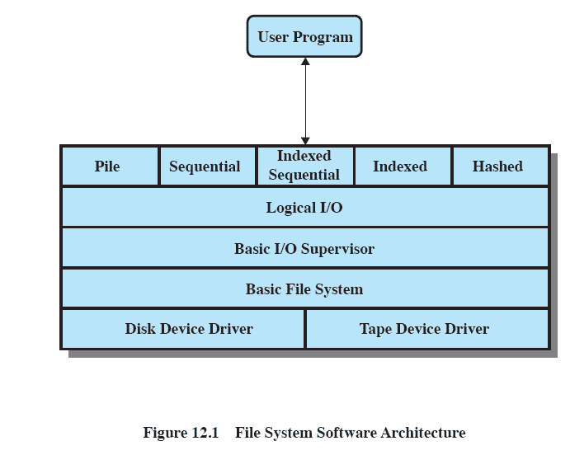
Typical File System Software Organization
Notes:
One way of getting a feel for the scope of file
management is to look at a depiction of a typical software organization, as suggested
in Figure 12.1 . Of course, different systems will be organized differently, but this
organization is reasonably representative.

Slide 14
File System Architecture
File Formats – Access methods provide the interface to users
Logical I/O
Basic I/O
Basic file system
Device drivers

Slide 15
Device Drivers
Lowest level
Communicates directly with peripheral devices
Responsible for starting I/O operations on a device
Processes the completion of an I/O request
Considered to be part of the operating system
Notes:
At the lowest level, device drivers
communicate directly with peripheral devices or their controllers or channels. A
device driver is responsible for starting I/O operations on a device and processing
the completion of an I/O request. For file operations, the typical devices controlled
are disk and tape drives. Device drivers are usually considered to be part of the
operating system.
15

Slide 16
Basic File System
Also referred to as the physical I/O level
Primary interface with the environment outside the computer system
Deals with blocks of data that are exchanged with disk or other mass storage devices.
placement of blocks on the secondary storage device
buffering blocks in main memory
Considered part of the operating system
Notes:
The next level is referred to as the basic file system , or the physical I/O level.
This is the primary interface with the environment outside of the computer system.
It deals with blocks of data that are exchanged with disk or tape systems. Thus, it is
concerned with the placement of those blocks on the secondary storage device and
on the buffering of those blocks in main memory. It does not understand the content
of the data or the structure of the files involved. The basic file system is often
considered part of the operating system.

Slide 17
Basic I/O Supervisor
Responsible for all file I/O initiation and termination
Control structures that deal with device I/O, scheduling, and file status are maintained
Selects the device on which I/O is to be performed
Concerned with scheduling disk and tape accesses to optimize performance
I/O buffers are assigned and secondary memory is allocated at this level
Part of the operating system
Notes:
The basic I/O supervisor is responsible for all file I/O initiation and termination.
At this level, control structures are maintained that deal with device I/O,
scheduling, and file status. The basic I/O supervisor selects the device on which file
I/O is to be performed, based on the particular file selected. It is also concerned
with scheduling disk and tape accesses to optimize performance. I/O buffers are
assigned and secondary memory is allocated at this level. The basic I/O supervisor is
part of the operating system.

Slide 18
Logical I/O
Enables users and applications to access records
Provides general-purpose record I/O capability
Maintains basic data about file
Notes:
Logical I/O enables users and applications to access records. Thus, whereas
the basic file system deals with blocks of data, the logical I/O module deals with file
records. Logical I/O provides a general-purpose record I/O capability and maintains
basic data about files.

Slide 19
Logical I/O
This level is the interface between the
logical commands issued by a program and the physical details required by the disk.
Logical units of data versus physical blocks of data to match disk requirements.
Notes:
Logical I/O enables users and applications to access records. Thus, whereas
the basic file system deals with blocks of data, the logical I/O module deals with file
records. Logical I/O provides a general-purpose record I/O capability and maintains
basic data about files.
19

Slide 20
Access Method
Level of the file system closest to the user
Provides a standard interface between applications and the file systems and devices that hold the data
Different access methods reflect different file structures and different ways of accessing and processing the data
Notes:
The level of the file system closest to the user is often termed the access
method . It provides a standard interface between applications and the file systems
and devices that hold the data. Different access methods reflect different file structures
and different ways of accessing and processing the data. Some of the most
common access methods are shown in Figure 12.1 , and these are briefly described
in Section 12.2 .

Slide 21
File Organization and Access
File organization is the logical structuring of the records as determined by the way in which they are accessed
In choosing a file organization, several criteria are important:
short access time
ease of update
economy of storage
simple maintenance
reliability
Relative Priority of these criteria depends on the application that will use the file
Notes:
In this section, we use the term file organization to refer to the logical structuring
of the records as determined by the way in which they are accessed. The physical
organization of the file on secondary storage depends on the blocking strategy and
the file allocation strategy, issues dealt with later in this chapter.
In choosing a file organization, several criteria are important:
• Short access time
• Ease of update
• Economy of storage
• Simple maintenance
• Reliability
The relative priority of these criteria will depend on the applications that will
use the file. For example, if a file is only to be processed in batch mode, with all of
the records accessed every time, then rapid access for retrieval of a single record is
of minimal concern. A file stored on CD-ROM will never be updated, and so ease
of update is not an issue.
These criteria may conflict. For example, for economy of storage, there should be
minimum redundancy in the data. On the other hand, redundancy is a primary means
of increasing the speed of access to data. An example of this is the use of indexes.

Slide 22
File Organization Types
Five of the common file organizations are:
The pile
The sequential file
The indexed sequential file
The indexed file
The direct, or hashed, file
Notes:
The number of alternative file organizations that have been implemented or
just proposed is unmanageably large, even for a book devoted to file systems. In this
brief survey, we will outline five fundamental organizations. Most structures used in
actual systems either fall into one of these categories or can be implemented with a
combination of these organizations. The five organizations, the first four of which
are depicted in Figure 12.3 , are as follows:
The pile
• The sequential file
• The indexed sequential file
• The indexed file
• The direct, or hashed, file

Slide 23
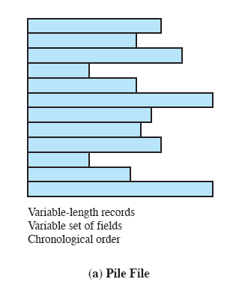
The Pile
Least complicated form of file organization
Data are collected in the order they arrive
Purpose is simply to accumulate the mass of data and save it
Notes:
The least-complicated form of file organization may be termed the pile . Data are
collected in the order in which they arrive. Each record consists of one burst of
data. The purpose of the pile is simply to accumulate the mass of data and save it.
Records may have different fields, or similar fields in different orders. Thus, each
field should be self-describing, including a field name as well as a value. The length
of each field must be implicitly indicated by delimiters, explicitly included as a subfield,
or known as default for that field type.
Because there is no structure to the pile file, record access is by exhaustive
search. That is, if we wish to find a record that contains a particular field with a
particular value, it is necessary to examine each record in the pile until the desired
record is found or the entire file has been searched. If we wish to find all records
that contain a particular field or contain that field with a particular value, then the
entire file must be searched.
Pile files are encountered when data are collected and stored prior to processing
or when data are not easy to organize. This type of file uses space well when the
stored data vary in size and structure, is perfectly adequate for exhaustive searches,
and is easy to update. However, beyond these limited uses, this type of file is unsuitable
for most applications.

Slide 24
The Pile
Each record consists of one burst of data
Records may have different fields, or similar fields in different orders.
Notes:
The least-complicated form of file organization may be termed the pile . Data are
collected in the order in which they arrive. Each record consists of one burst of
data. The purpose of the pile is simply to accumulate the mass of data and save it.
Records may have different fields, or similar fields in different orders. Thus, each
field should be self-describing, including a field name as well as a value. The length
of each field must be implicitly indicated by delimiters, explicitly included as a subfield,
or known as default for that field type.
Because there is no structure to the pile file, record access is by exhaustive
search. That is, if we wish to find a record that contains a particular field with a
particular value, it is necessary to examine each record in the pile until the desired
record is found or the entire file has been searched. If we wish to find all records
that contain a particular field or contain that field with a particular value, then the
entire file must be searched.
Pile files are encountered when data are collected and stored prior to processing
or when data are not easy to organize. This type of file uses space well when the
stored data vary in size and structure, is perfectly adequate for exhaustive searches,
and is easy to update. However, beyond these limited uses, this type of file is unsuitable
for most applications.

Slide 25
The Pile
Because there is no structure to the pile file, record access is by exhaustive search.
That is, if we wish to find a record that contains a particular field with a particular value,
it is necessary to examine each record in the pile until the desired record is found or the entire file has been searched
Notes:
The least-complicated form of file organization may be termed the pile . Data are
collected in the order in which they arrive. Each record consists of one burst of
data. The purpose of the pile is simply to accumulate the mass of data and save it.
Records may have different fields, or similar fields in different orders. Thus, each
field should be self-describing, including a field name as well as a value. The length
of each field must be implicitly indicated by delimiters, explicitly included as a subfield,
or known as default for that field type.
Because there is no structure to the pile file, record access is by exhaustive
search. That is, if we wish to find a record that contains a particular field with a
particular value, it is necessary to examine each record in the pile until the desired
record is found or the entire file has been searched. If we wish to find all records
that contain a particular field or contain that field with a particular value, then the
entire file must be searched.
Pile files are encountered when data are collected and stored prior to processing
or when data are not easy to organize. This type of file uses space well when the
stored data vary in size and structure, is perfectly adequate for exhaustive searches,
and is easy to update. However, beyond these limited uses, this type of file is unsuitable
for most applications.

Slide 26
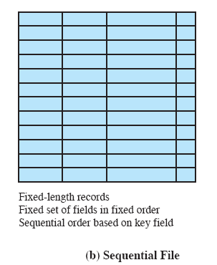
The Sequential File
Most common form of file structure
A fixed format is used for records
All records are of the same length,
Records consist of the same number of fixed-length fields in a particular order.
Notes:
The most common form of file structure is the sequential file. In this type of file,
a fixed format is used for records. All records are of the same length, consisting of
the same number of fixed-length fields in a particular order. Because the length and
position of each field are known, only the values of fields need to be stored; the field
name and length for each field are attributes of the file structure.
One particular field, usually the first field in each record, is referred to as the
key field . The key field uniquely identifies the record; thus key values for different
records are always different. Further, the records are stored in key sequence: alphabetical
order for a text key, and numerical order for a numerical key.
Sequential files are typically used in batch applications and are generally
optimum for such applications if they involve the processing of all the records (e.g.,
a billing or payroll application). The sequential file organization is the only one that
is easily stored on tape as well as disk.
For interactive applications that involve queries and/or updates of individual
records, the sequential file provides poor performance. Access requires the sequential
search of the file for a key match. If the entire file, or a large portion of the
file, can be brought into main memory at one time, more efficient search techniques
are possible. Nevertheless, considerable processing and delay are encountered to
access a record in a large sequential file. Additions to the file also present problems.
Typically, a sequential file is stored in simple sequential ordering of the records within
blocks. That is, the physical organization of the file on tape or disk directly matches
the logical organization of the file. In this case, the usual procedure is to place new
records in a separate pile file, called a log file or transaction file. Periodically, a batch
update is performed that merges the log file with the master file to produce a new file
in correct key sequence.
An alternative is to organize the sequential file physically as a linked list. One
or more records are stored in each physical block. Each block on disk contains a
pointer to the next block. The insertion of new records involves pointer manipulation
but does not require that the new records occupy a particular physical block
position. Thus, some added convenience is obtained at the cost of additional
processing and overhead.

Slide 27
The Sequential File
One particular field, usually the first field in each record, is referred to as the key field .
The key field uniquely identifies the record;
Thus key values for different records are always different.
Notes:
The most common form of file structure is the sequential file. In this type of file,
a fixed format is used for records. All records are of the same length, consisting of
the same number of fixed-length fields in a particular order. Because the length and
position of each field are known, only the values of fields need to be stored; the field
name and length for each field are attributes of the file structure.
One particular field, usually the first field in each record, is referred to as the
key field . The key field uniquely identifies the record; thus key values for different
records are always different. Further, the records are stored in key sequence: alphabetical
order for a text key, and numerical order for a numerical key.
Sequential files are typically used in batch applications and are generally
optimum for such applications if they involve the processing of all the records (e.g.,
a billing or payroll application). The sequential file organization is the only one that
is easily stored on tape as well as disk.
For interactive applications that involve queries and/or updates of individual
records, the sequential file provides poor performance. Access requires the sequential
search of the file for a key match. If the entire file, or a large portion of the
file, can be brought into main memory at one time, more efficient search techniques
are possible. Nevertheless, considerable processing and delay are encountered to
access a record in a large sequential file. Additions to the file also present problems.
Typically, a sequential file is stored in simple sequential ordering of the records within
blocks. That is, the physical organization of the file on tape or disk directly matches
the logical organization of the file. In this case, the usual procedure is to place new
records in a separate pile file, called a log file or transaction file. Periodically, a batch
update is performed that merges the log file with the master file to produce a new file
in correct key sequence.
An alternative is to organize the sequential file physically as a linked list. One
or more records are stored in each physical block. Each block on disk contains a
pointer to the next block. The insertion of new records involves pointer manipulation
but does not require that the new records occupy a particular physical block
position. Thus, some added convenience is obtained at the cost of additional
processing and overhead.

Slide 28
The Sequential File
The records are stored in key sequence:
alphabetical order for a text key, and
numerical order for a numerical key.
Notes:
The most common form of file structure is the sequential file. In this type of file,
a fixed format is used for records. All records are of the same length, consisting of
the same number of fixed-length fields in a particular order. Because the length and
position of each field are known, only the values of fields need to be stored; the field
name and length for each field are attributes of the file structure.
One particular field, usually the first field in each record, is referred to as the
key field . The key field uniquely identifies the record; thus key values for different
records are always different. Further, the records are stored in key sequence: alphabetical
order for a text key, and numerical order for a numerical key.
Sequential files are typically used in batch applications and are generally
optimum for such applications if they involve the processing of all the records (e.g.,
a billing or payroll application). The sequential file organization is the only one that
is easily stored on tape as well as disk.
For interactive applications that involve queries and/or updates of individual
records, the sequential file provides poor performance. Access requires the sequential
search of the file for a key match. If the entire file, or a large portion of the
file, can be brought into main memory at one time, more efficient search techniques
are possible. Nevertheless, considerable processing and delay are encountered to
access a record in a large sequential file. Additions to the file also present problems.
Typically, a sequential file is stored in simple sequential ordering of the records within
blocks. That is, the physical organization of the file on tape or disk directly matches
the logical organization of the file. In this case, the usual procedure is to place new
records in a separate pile file, called a log file or transaction file. Periodically, a batch
update is performed that merges the log file with the master file to produce a new file
in correct key sequence.
An alternative is to organize the sequential file physically as a linked list. One
or more records are stored in each physical block. Each block on disk contains a
pointer to the next block. The insertion of new records involves pointer manipulation
but does not require that the new records occupy a particular physical block
position. Thus, some added convenience is obtained at the cost of additional
processing and overhead.

Slide 29
The Sequential File
Typically used in batch applications if they involve the processing of all the records (e.g., a billing or payroll application).
Easily stored on tape as well as disk
Notes:
The most common form of file structure is the sequential file. In this type of file,
a fixed format is used for records. All records are of the same length, consisting of
the same number of fixed-length fields in a particular order. Because the length and
position of each field are known, only the values of fields need to be stored; the field
name and length for each field are attributes of the file structure.
One particular field, usually the first field in each record, is referred to as the
key field . The key field uniquely identifies the record; thus key values for different
records are always different. Further, the records are stored in key sequence: alphabetical
order for a text key, and numerical order for a numerical key.
Sequential files are typically used in batch applications and are generally
optimum for such applications if they involve the processing of all the records (e.g.,
a billing or payroll application). The sequential file organization is the only one that
is easily stored on tape as well as disk.
For interactive applications that involve queries and/or updates of individual
records, the sequential file provides poor performance. Access requires the sequential
search of the file for a key match. If the entire file, or a large portion of the
file, can be brought into main memory at one time, more efficient search techniques
are possible. Nevertheless, considerable processing and delay are encountered to
access a record in a large sequential file. Additions to the file also present problems.
Typically, a sequential file is stored in simple sequential ordering of the records within
blocks. That is, the physical organization of the file on tape or disk directly matches
the logical organization of the file. In this case, the usual procedure is to place new
records in a separate pile file, called a log file or transaction file. Periodically, a batch
update is performed that merges the log file with the master file to produce a new file
in correct key sequence.
An alternative is to organize the sequential file physically as a linked list. One
or more records are stored in each physical block. Each block on disk contains a
pointer to the next block. The insertion of new records involves pointer manipulation
but does not require that the new records occupy a particular physical block
position. Thus, some added convenience is obtained at the cost of additional
processing and overhead.

Slide 30
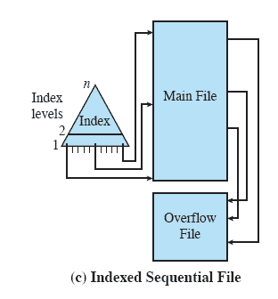
Indexed Sequential File
The indexed sequential file maintains the key characteristic of the sequential file:
Records are organized in sequence based on a key field
Notes:
A popular approach to overcoming the disadvantages of the sequential file is the
indexed sequential file. The indexed sequential file maintains the key characteristic
of the sequential file: Records are organized in sequence based on a key field. Two
features are added: an index to the file to support random access, and an overflow
file. The index provides a lookup capability to reach quickly the vicinity of a desired
record. The overflow file is similar to the log file used with a sequential file but is
integrated so that a record in the overflow file is located by following a pointer from
its predecessor record.
In the simplest indexed sequential structure, a single level of indexing is
used. The index in this case is a simple sequential file. Each record in the index file
consists of two fields: a key field, which is the same as the key field in the main file,
and a pointer into the main file. To find a specific field, the index is searched to find
the highest key value that is equal to or precedes the desired key value. The search
continues in the main file at the location indicated by the pointer.
To see the effectiveness of this approach, consider a sequential file with
1 million records. To search for a particular key value will require on average one-half
million record accesses. Now suppose that an index containing 1,000 entries
is constructed, with the keys in the index more or less evenly distributed over
the main file. Now it will take on average 500 accesses to the index file followed
by 500 accesses to the main file to find the record. The average search length is
reduced from 500,000 to 1,000.
Additions to the file are handled in the following manner: Each record in
the main file contains an additional field not visible to the application, which is a
pointer to the overflow file. When a new record is to be inserted into the file, it is
added to the overflow file. The record in the main file that immediately precedes
the new record in logical sequence is updated to contain a pointer to the new record
in the overflow file. If the immediately preceding record is itself in the overflow file,
then the pointer in that record is updated. As with the sequential file, the indexed
sequential file is occasionally merged with the overflow file in batch mode.
The indexed sequential file greatly reduces the time required to access a single
record, without sacrificing the sequential nature of the file. To process the entire file
sequentially, the records of the main file are processed in sequence until a pointer
to the overflow file is found, then accessing continues in the overflow file until a null
pointer is encountered, at which time accessing of the main file is resumed where it
left off.
To provide even greater efficiency in access, multiple levels of indexing can be
used. Thus the lowest level of index file is treated as a sequential file and a higher level
index file is created for that file. Consider again a file with 1 million records.
A lower-level index with 10,000 entries is constructed. A higher-level index into
the lower-level index of 100 entries can then be constructed. The search begins at
the higher-level index (average length = 50 accesses) to find an entry point into the
lower-level index. This index is then searched (average length = 50) to find an entry
point into the main file, which is then searched (average length = 50). Thus the average
length of search has been reduced from 500,000 to 1,000 to 150.

Slide 31
Indexed Sequential File
Two features are added:-
Adds an index to the file to support random access
An overflow file.
Notes:
A popular approach to overcoming the disadvantages of the sequential file is the
indexed sequential file. The indexed sequential file maintains the key characteristic
of the sequential file: Records are organized in sequence based on a key field. Two
features are added: an index to the file to support random access, and an overflow
file. The index provides a lookup capability to reach quickly the vicinity of a desired
record. The overflow file is similar to the log file used with a sequential file but is
integrated so that a record in the overflow file is located by following a pointer from
its predecessor record.
In the simplest indexed sequential structure, a single level of indexing is
used. The index in this case is a simple sequential file. Each record in the index file
consists of two fields: a key field, which is the same as the key field in the main file,
and a pointer into the main file. To find a specific field, the index is searched to find
the highest key value that is equal to or precedes the desired key value. The search
continues in the main file at the location indicated by the pointer.
To see the effectiveness of this approach, consider a sequential file with
1 million records. To search for a particular key value will require on average one-half
million record accesses. Now suppose that an index containing 1,000 entries
is constructed, with the keys in the index more or less evenly distributed over
the main file. Now it will take on average 500 accesses to the index file followed
by 500 accesses to the main file to find the record. The average search length is
reduced from 500,000 to 1,000.
Additions to the file are handled in the following manner: Each record in
the main file contains an additional field not visible to the application, which is a
pointer to the overflow file. When a new record is to be inserted into the file, it is
added to the overflow file. The record in the main file that immediately precedes
the new record in logical sequence is updated to contain a pointer to the new record
in the overflow file. If the immediately preceding record is itself in the overflow file,
then the pointer in that record is updated. As with the sequential file, the indexed
sequential file is occasionally merged with the overflow file in batch mode.
The indexed sequential file greatly reduces the time required to access a single
record, without sacrificing the sequential nature of the file. To process the entire file
sequentially, the records of the main file are processed in sequence until a pointer
to the overflow file is found, then accessing continues in the overflow file until a null
pointer is encountered, at which time accessing of the main file is resumed where it
left off.
To provide even greater efficiency in access, multiple levels of indexing can be
used. Thus the lowest level of index file is treated as a sequential file and a higher level
index file is created for that file. Consider again a file with 1 million records.
A lower-level index with 10,000 entries is constructed. A higher-level index into
the lower-level index of 100 entries can then be constructed. The search begins at
the higher-level index (average length = 50 accesses) to find an entry point into the
lower-level index. This index is then searched (average length = 50) to find an entry
point into the main file, which is then searched (average length = 50). Thus the average
length of search has been reduced from 500,000 to 1,000 to 150.

Slide 32
Indexed Sequential File
Each record in the index file consists of two fields:
a key field, which is the same as the key field in the main file,
and a pointer into the main file.
Notes:
A popular approach to overcoming the disadvantages of the sequential file is the
indexed sequential file. The indexed sequential file maintains the key characteristic
of the sequential file: Records are organized in sequence based on a key field. Two
features are added: an index to the file to support random access, and an overflow
file. The index provides a lookup capability to reach quickly the vicinity of a desired
record. The overflow file is similar to the log file used with a sequential file but is
integrated so that a record in the overflow file is located by following a pointer from
its predecessor record.
In the simplest indexed sequential structure, a single level of indexing is
used. The index in this case is a simple sequential file. Each record in the index file
consists of two fields: a key field, which is the same as the key field in the main file,
and a pointer into the main file. To find a specific field, the index is searched to find
the highest key value that is equal to or precedes the desired key value. The search
continues in the main file at the location indicated by the pointer.
To see the effectiveness of this approach, consider a sequential file with
1 million records. To search for a particular key value will require on average one-half
million record accesses. Now suppose that an index containing 1,000 entries
is constructed, with the keys in the index more or less evenly distributed over
the main file. Now it will take on average 500 accesses to the index file followed
by 500 accesses to the main file to find the record. The average search length is
reduced from 500,000 to 1,000.
Additions to the file are handled in the following manner: Each record in
the main file contains an additional field not visible to the application, which is a
pointer to the overflow file. When a new record is to be inserted into the file, it is
added to the overflow file. The record in the main file that immediately precedes
the new record in logical sequence is updated to contain a pointer to the new record
in the overflow file. If the immediately preceding record is itself in the overflow file,
then the pointer in that record is updated. As with the sequential file, the indexed
sequential file is occasionally merged with the overflow file in batch mode.
The indexed sequential file greatly reduces the time required to access a single
record, without sacrificing the sequential nature of the file. To process the entire file
sequentially, the records of the main file are processed in sequence until a pointer
to the overflow file is found, then accessing continues in the overflow file until a null
pointer is encountered, at which time accessing of the main file is resumed where it
left off.
To provide even greater efficiency in access, multiple levels of indexing can be
used. Thus the lowest level of index file is treated as a sequential file and a higher level
index file is created for that file. Consider again a file with 1 million records.
A lower-level index with 10,000 entries is constructed. A higher-level index into
the lower-level index of 100 entries can then be constructed. The search begins at
the higher-level index (average length = 50 accesses) to find an entry point into the
lower-level index. This index is then searched (average length = 50) to find an entry
point into the main file, which is then searched (average length = 50). Thus the average
length of search has been reduced from 500,000 to 1,000 to 150.

Slide 33
Indexed Sequential File
To find a specific field, the index is searched to find the highest key value that is equal to or precedes the desired key value.
The search continues in the main file at the location indicated by the pointer.
Notes:
A popular approach to overcoming the disadvantages of the sequential file is the
indexed sequential file. The indexed sequential file maintains the key characteristic
of the sequential file: Records are organized in sequence based on a key field. Two
features are added: an index to the file to support random access, and an overflow
file. The index provides a lookup capability to reach quickly the vicinity of a desired
record. The overflow file is similar to the log file used with a sequential file but is
integrated so that a record in the overflow file is located by following a pointer from
its predecessor record.
In the simplest indexed sequential structure, a single level of indexing is
used. The index in this case is a simple sequential file. Each record in the index file
consists of two fields: a key field, which is the same as the key field in the main file,
and a pointer into the main file. To find a specific field, the index is searched to find
the highest key value that is equal to or precedes the desired key value. The search
continues in the main file at the location indicated by the pointer.
To see the effectiveness of this approach, consider a sequential file with
1 million records. To search for a particular key value will require on average one-half
million record accesses. Now suppose that an index containing 1,000 entries
is constructed, with the keys in the index more or less evenly distributed over
the main file. Now it will take on average 500 accesses to the index file followed
by 500 accesses to the main file to find the record. The average search length is
reduced from 500,000 to 1,000.
Additions to the file are handled in the following manner: Each record in
the main file contains an additional field not visible to the application, which is a
pointer to the overflow file. When a new record is to be inserted into the file, it is
added to the overflow file. The record in the main file that immediately precedes
the new record in logical sequence is updated to contain a pointer to the new record
in the overflow file. If the immediately preceding record is itself in the overflow file,
then the pointer in that record is updated. As with the sequential file, the indexed
sequential file is occasionally merged with the overflow file in batch mode.
The indexed sequential file greatly reduces the time required to access a single
record, without sacrificing the sequential nature of the file. To process the entire file
sequentially, the records of the main file are processed in sequence until a pointer
to the overflow file is found, then accessing continues in the overflow file until a null
pointer is encountered, at which time accessing of the main file is resumed where it
left off.
To provide even greater efficiency in access, multiple levels of indexing can be
used. Thus the lowest level of index file is treated as a sequential file and a higher level
index file is created for that file. Consider again a file with 1 million records.
A lower-level index with 10,000 entries is constructed. A higher-level index into
the lower-level index of 100 entries can then be constructed. The search begins at
the higher-level index (average length = 50 accesses) to find an entry point into the
lower-level index. This index is then searched (average length = 50) to find an entry
point into the main file, which is then searched (average length = 50). Thus the average
length of search has been reduced from 500,000 to 1,000 to 150.

Slide 34
Indexed Sequential File
Consider a sequential file with 1 million records.
To search for a particular key value will require on average one half million record accesses.
Now suppose that an index containing 1,000 entries is constructed, with the keys in the index more or less evenly distributed over the main file.
The average search length is reduced.
Notes:
A popular approach to overcoming the disadvantages of the sequential file is the
indexed sequential file. The indexed sequential file maintains the key characteristic
of the sequential file: Records are organized in sequence based on a key field. Two
features are added: an index to the file to support random access, and an overflow
file. The index provides a lookup capability to reach quickly the vicinity of a desired
record. The overflow file is similar to the log file used with a sequential file but is
integrated so that a record in the overflow file is located by following a pointer from
its predecessor record.
In the simplest indexed sequential structure, a single level of indexing is
used. The index in this case is a simple sequential file. Each record in the index file
consists of two fields: a key field, which is the same as the key field in the main file,
and a pointer into the main file. To find a specific field, the index is searched to find
the highest key value that is equal to or precedes the desired key value. The search
continues in the main file at the location indicated by the pointer.
To see the effectiveness of this approach, consider a sequential file with
1 million records. To search for a particular key value will require on average one-half
million record accesses. Now suppose that an index containing 1,000 entries
is constructed, with the keys in the index more or less evenly distributed over
the main file. Now it will take on average 500 accesses to the index file followed
by 500 accesses to the main file to find the record. The average search length is
reduced from 500,000 to 1,000.
Additions to the file are handled in the following manner: Each record in
the main file contains an additional field not visible to the application, which is a
pointer to the overflow file. When a new record is to be inserted into the file, it is
added to the overflow file. The record in the main file that immediately precedes
the new record in logical sequence is updated to contain a pointer to the new record
in the overflow file. If the immediately preceding record is itself in the overflow file,
then the pointer in that record is updated. As with the sequential file, the indexed
sequential file is occasionally merged with the overflow file in batch mode.
The indexed sequential file greatly reduces the time required to access a single
record, without sacrificing the sequential nature of the file. To process the entire file
sequentially, the records of the main file are processed in sequence until a pointer
to the overflow file is found, then accessing continues in the overflow file until a null
pointer is encountered, at which time accessing of the main file is resumed where it
left off.
To provide even greater efficiency in access, multiple levels of indexing can be
used. Thus the lowest level of index file is treated as a sequential file and a higher level
index file is created for that file. Consider again a file with 1 million records.
A lower-level index with 10,000 entries is constructed. A higher-level index into
the lower-level index of 100 entries can then be constructed. The search begins at
the higher-level index (average length = 50 accesses) to find an entry point into the
lower-level index. This index is then searched (average length = 50) to find an entry
point into the main file, which is then searched (average length = 50). Thus the average
length of search has been reduced from 500,000 to 1,000 to 150.

Slide 35
Indexed Sequential File
Additions to the file are handled in the following manner:
Each record in the main file contains an additional field not visible to the application, which is a pointer to the overflow file.
Notes:
A popular approach to overcoming the disadvantages of the sequential file is the
indexed sequential file. The indexed sequential file maintains the key characteristic
of the sequential file: Records are organized in sequence based on a key field. Two
features are added: an index to the file to support random access, and an overflow
file. The index provides a lookup capability to reach quickly the vicinity of a desired
record. The overflow file is similar to the log file used with a sequential file but is
integrated so that a record in the overflow file is located by following a pointer from
its predecessor record.
In the simplest indexed sequential structure, a single level of indexing is
used. The index in this case is a simple sequential file. Each record in the index file
consists of two fields: a key field, which is the same as the key field in the main file,
and a pointer into the main file. To find a specific field, the index is searched to find
the highest key value that is equal to or precedes the desired key value. The search
continues in the main file at the location indicated by the pointer.
To see the effectiveness of this approach, consider a sequential file with
1 million records. To search for a particular key value will require on average one-half
million record accesses. Now suppose that an index containing 1,000 entries
is constructed, with the keys in the index more or less evenly distributed over
the main file. Now it will take on average 500 accesses to the index file followed
by 500 accesses to the main file to find the record. The average search length is
reduced from 500,000 to 1,000.
Additions to the file are handled in the following manner: Each record in
the main file contains an additional field not visible to the application, which is a
pointer to the overflow file. When a new record is to be inserted into the file, it is
added to the overflow file. The record in the main file that immediately precedes
the new record in logical sequence is updated to contain a pointer to the new record
in the overflow file. If the immediately preceding record is itself in the overflow file,
then the pointer in that record is updated. As with the sequential file, the indexed
sequential file is occasionally merged with the overflow file in batch mode.
The indexed sequential file greatly reduces the time required to access a single
record, without sacrificing the sequential nature of the file. To process the entire file
sequentially, the records of the main file are processed in sequence until a pointer
to the overflow file is found, then accessing continues in the overflow file until a null
pointer is encountered, at which time accessing of the main file is resumed where it
left off.
To provide even greater efficiency in access, multiple levels of indexing can be
used. Thus the lowest level of index file is treated as a sequential file and a higher level
index file is created for that file. Consider again a file with 1 million records.
A lower-level index with 10,000 entries is constructed. A higher-level index into
the lower-level index of 100 entries can then be constructed. The search begins at
the higher-level index (average length = 50 accesses) to find an entry point into the
lower-level index. This index is then searched (average length = 50) to find an entry
point into the main file, which is then searched (average length = 50). Thus the average
length of search has been reduced from 500,000 to 1,000 to 150.

Slide 36
Indexed Sequential File
When a new record is to be inserted into the file,
it is added to the overflow file.
The record in the main file that immediately precedes the new record in logical sequence is updated to contain a pointer to the new record in the overflow file.
Notes:
A popular approach to overcoming the disadvantages of the sequential file is the
indexed sequential file. The indexed sequential file maintains the key characteristic
of the sequential file: Records are organized in sequence based on a key field. Two
features are added: an index to the file to support random access, and an overflow
file. The index provides a lookup capability to reach quickly the vicinity of a desired
record. The overflow file is similar to the log file used with a sequential file but is
integrated so that a record in the overflow file is located by following a pointer from
its predecessor record.
In the simplest indexed sequential structure, a single level of indexing is
used. The index in this case is a simple sequential file. Each record in the index file
consists of two fields: a key field, which is the same as the key field in the main file,
and a pointer into the main file. To find a specific field, the index is searched to find
the highest key value that is equal to or precedes the desired key value. The search
continues in the main file at the location indicated by the pointer.
To see the effectiveness of this approach, consider a sequential file with
1 million records. To search for a particular key value will require on average one-half
million record accesses. Now suppose that an index containing 1,000 entries
is constructed, with the keys in the index more or less evenly distributed over
the main file. Now it will take on average 500 accesses to the index file followed
by 500 accesses to the main file to find the record. The average search length is
reduced from 500,000 to 1,000.
Additions to the file are handled in the following manner: Each record in
the main file contains an additional field not visible to the application, which is a
pointer to the overflow file. When a new record is to be inserted into the file, it is
added to the overflow file. The record in the main file that immediately precedes
the new record in logical sequence is updated to contain a pointer to the new record
in the overflow file. If the immediately preceding record is itself in the overflow file,
then the pointer in that record is updated. As with the sequential file, the indexed
sequential file is occasionally merged with the overflow file in batch mode.
The indexed sequential file greatly reduces the time required to access a single
record, without sacrificing the sequential nature of the file. To process the entire file
sequentially, the records of the main file are processed in sequence until a pointer
to the overflow file is found, then accessing continues in the overflow file until a null
pointer is encountered, at which time accessing of the main file is resumed where it
left off.
To provide even greater efficiency in access, multiple levels of indexing can be
used. Thus the lowest level of index file is treated as a sequential file and a higher level
index file is created for that file. Consider again a file with 1 million records.
A lower-level index with 10,000 entries is constructed. A higher-level index into
the lower-level index of 100 entries can then be constructed. The search begins at
the higher-level index (average length = 50 accesses) to find an entry point into the
lower-level index. This index is then searched (average length = 50) to find an entry
point into the main file, which is then searched (average length = 50). Thus the average
length of search has been reduced from 500,000 to 1,000 to 150.

Slide 37
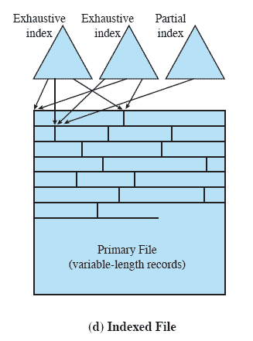
Indexed File
A structure is needed that employs multiple indexes, one for each type of field that may be the subject of a search.
Records are accessed only through their indexes
The result is that there is now no restriction on the placement of records as long as a pointer in at least one index refers to that record.
Variable-length records can be employed
Notes:
The indexed sequential file retains one limitation of the sequential file: Effective
processing is limited to that which is based on a single field of the file. For example,
when it is necessary to search for a record on the basis of some other attribute than
the key field, both forms of sequential file are inadequate. In some applications, the
flexibility of efficiently searching by various attributes is desirable.
To achieve this flexibility, a structure is needed that employs multiple indexes,
one for each type of field that may be the subject of a search. In the general indexed
file, the concept of sequentially and a single key are abandoned. Records are
accessed only through their indexes. The result is that there is now no restriction
on the placement of records as long as a pointer in at least one index refers to that
record. Furthermore, variable-length records can be employed.
Two types of indexes are used. An exhaustive index contains one entry for
every record in the main file. The index itself is organized as a sequential file for
ease of searching. A partial index contains entries to records where the field of
interest exists. With variable-length records, some records will not contain all fields.
When a new record is added to the main file, all of the index files must be updated.
Indexed files are used mostly in applications where timeliness of information
is critical and where data are rarely processed exhaustively. Examples are airline
reservation systems and inventory control systems.

Slide 38
Indexed File
Two types of indexes are used.
An exhaustive index contains one entry for every record in the main file.
A partial index contains entries to records where the field of interest exists.
With variable-length records, some records will not contain all fields.
Notes:
The indexed sequential file retains one limitation of the sequential file: Effective
processing is limited to that which is based on a single field of the file. For example,
when it is necessary to search for a record on the basis of some other attribute than
the key field, both forms of sequential file are inadequate. In some applications, the
flexibility of efficiently searching by various attributes is desirable.
To achieve this flexibility, a structure is needed that employs multiple indexes,
one for each type of field that may be the subject of a search. In the general indexed
file, the concept of sequentially and a single key are abandoned. Records are
accessed only through their indexes. The result is that there is now no restriction
on the placement of records as long as a pointer in at least one index refers to that
record. Furthermore, variable-length records can be employed.
Two types of indexes are used. An exhaustive index contains one entry for
every record in the main file. The index itself is organized as a sequential file for
ease of searching. A partial index contains entries to records where the field of
interest exists. With variable-length records, some records will not contain all fields.
When a new record is added to the main file, all of the index files must be updated.
Indexed files are used mostly in applications where timeliness of information
is critical and where data are rarely processed exhaustively. Examples are airline
reservation systems and inventory control systems.

Slide 39
Indexed File
Indexed files are used mostly in applications where timeliness is critical and where data are rarely processed exhaustively.
Examples are airline reservation systems and inventory control systems.
Notes:
The indexed sequential file retains one limitation of the sequential file: Effective
processing is limited to that which is based on a single field of the file. For example,
when it is necessary to search for a record on the basis of some other attribute than
the key field, both forms of sequential file are inadequate. In some applications, the
flexibility of efficiently searching by various attributes is desirable.
To achieve this flexibility, a structure is needed that employs multiple indexes,
one for each type of field that may be the subject of a search. In the general indexed
file, the concept of sequentially and a single key are abandoned. Records are
accessed only through their indexes. The result is that there is now no restriction
on the placement of records as long as a pointer in at least one index refers to that
record. Furthermore, variable-length records can be employed.
Two types of indexes are used. An exhaustive index contains one entry for
every record in the main file. The index itself is organized as a sequential file for
ease of searching. A partial index contains entries to records where the field of
interest exists. With variable-length records, some records will not contain all fields.
When a new record is added to the main file, all of the index files must be updated.
Indexed files are used mostly in applications where timeliness of information
is critical and where data are rarely processed exhaustively. Examples are airline
reservation systems and inventory control systems.

Slide 40
Indexed File
When a new record is added to the main file, all of the index files must be updated.
Used mostly in applications where timeliness of information is critical
Examples would be airline reservation systems and inventory control systems
Notes:
The indexed sequential file retains one limitation of the sequential file: Effective
processing is limited to that which is based on a single field of the file. For example,
when it is necessary to search for a record on the basis of some other attribute than
the key field, both forms of sequential file are inadequate. In some applications, the
flexibility of efficiently searching by various attributes is desirable.
To achieve this flexibility, a structure is needed that employs multiple indexes,
one for each type of field that may be the subject of a search. In the general indexed
file, the concept of sequentially and a single key are abandoned. Records are
accessed only through their indexes. The result is that there is now no restriction
on the placement of records as long as a pointer in at least one index refers to that
record. Furthermore, variable-length records can be employed.
Two types of indexes are used. An exhaustive index contains one entry for
every record in the main file. The index itself is organized as a sequential file for
ease of searching. A partial index contains entries to records where the field of
interest exists. With variable-length records, some records will not contain all fields.
When a new record is added to the main file, all of the index files must be updated.
Indexed files are used mostly in applications where timeliness of information
is critical and where data are rarely processed exhaustively. Examples are airline
reservation systems and inventory control systems.

Slide 41
Direct or Hashed File
The direct file makes use of hashing on the key value.
No concept of sequential ordering here.
Examples are:
directories
pricing tables
schedules
name lists
Notes:
The direct, or hashed, file exploits the capability found on disks to access directly any
block of a known address. As with sequential and indexed sequential files, a key field
is required in each record. However, there is no concept of sequential ordering here.
The direct file makes use of hashing on the key value. This function is explained
in Appendix F . Figure F.1b shows the type of hashing organization with an overflow
file that is typically used in a hash file.
Direct files are often used where very rapid access is required, where fixed length
records are used, and where records are always accessed one at a time.
Examples are directories, pricing tables, schedules, and name lists.

Slide 42
Direct or Hashed File
Often used where:
very rapid access is required
fixed-length records are used
records are always accessed one at a time
Examples are directories, pricing tables, schedules, and name lists.
Examples are:
directories
pricing tables
schedules
name lists
Notes:
The direct, or hashed, file exploits the capability found on disks to access directly any
block of a known address. As with sequential and indexed sequential files, a key field
is required in each record. However, there is no concept of sequential ordering here.
The direct file makes use of hashing on the key value. This function is explained
in Appendix F . Figure F.1b shows the type of hashing organization with an overflow
file that is typically used in a hash file.
Direct files are often used where very rapid access is required, where fixed length
records are used, and where records are always accessed one at a time.
Examples are directories, pricing tables, schedules, and name lists.

Slide 43

File Directory Information
Table 12.2 Information Elements of a File Directory
Associated with any file management system and collection of files is a file directory.
The directory contains information about the files, including attributes, location, and ownership.
The directory is itself a file, accessible by various file management routines.
Notes:
Associated with any file management system and collection of files is a file directory.
The directory contains information about the files, including attributes, location,
and ownership. Much of this information, especially that concerned with storage,
is managed by the operating system. The directory is itself a file, accessible by various
file management routines. Although some of the information in directories is
available to users and applications, this is generally provided indirectly by system
routines.
Table 12.2 suggests the information typically stored in the directory for each
file in the system. From the user’s point of view, the directory provides a mapping
between file names, known to users and applications, and the files themselves. Thus,
each file entry includes the name of the file. Virtually all systems deal with different
types of files and different file organizations, and this information is also provided.
An important category of information about each file concerns its storage, including
its location and size. In shared systems, it is also important to provide information
that is used to control access to the file. Typically, one user is the owner of the file
and may grant certain access privileges to other users. Finally, usage information is
needed to manage the current use of the file and to record the history of its usage.

Slide 44
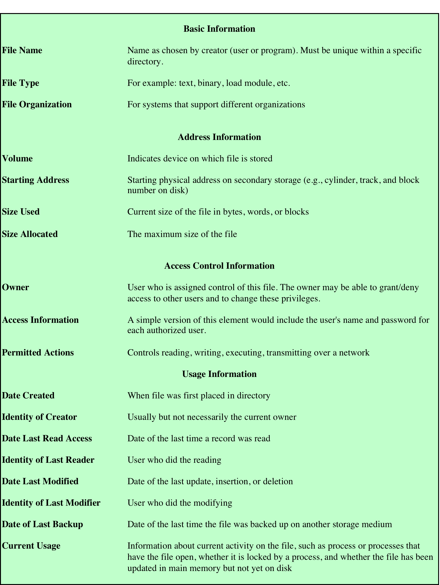
File Directory Information
Table 12.2 Information Elements of a File Directory
Table-the information typically stored in the directory for each file in the system.
Notes:
Associated with any file management system and collection of files is a file directory.
The directory contains information about the files, including attributes, location,
and ownership. Much of this information, especially that concerned with storage,
is managed by the operating system. The directory is itself a file, accessible by various
file management routines. Although some of the information in directories is
available to users and applications, this is generally provided indirectly by system
routines.
Table 12.2 suggests the information typically stored in the directory for each
file in the system. From the user’s point of view, the directory provides a mapping
between file names, known to users and applications, and the files themselves. Thus,
each file entry includes the name of the file. Virtually all systems deal with different
types of files and different file organizations, and this information is also provided.
An important category of information about each file concerns its storage, including
its location and size. In shared systems, it is also important to provide information
that is used to control access to the file. Typically, one user is the owner of the file
and may grant certain access privileges to other users. Finally, usage information is
needed to manage the current use of the file and to record the history of its usage.

Slide 45

Operations Performed on a Directory
Search
Create files
Delete files
List directory
Update directory
To understand the requirements for a file structure, it is helpful to consider the types of operations that may be performed on the directory:
Notes:
To understand the requirements for a file structure, it is helpful to consider
the types of operations that may be performed on the directory:
• Search: When a user or application references a file, the directory must be
searched to find the entry corresponding to that file.
• Create file: When a new file is created, an entry must be added to the directory.
• Delete file: When a file is deleted, an entry must be removed from the directory.
• List directory: All or a portion of the directory may be requested. Generally,
this request is made by a user and results in a listing of all files owned by that
user, plus some of the attributes of each file (e.g., type, access control information,
usage information).
• Update directory: Because some file attributes are stored in the directory, a
change in one of these attributes requires a change in the corresponding directory
entry.
The simple list is not suited to supporting these operations. Consider the needs
of a single user. The user may have many types of files, including word-processing
text files, graphic files, spreadsheets, and so on. The user may like to have these
organized by project, by type, or in some other convenient way. If the directory is a
simple sequential list, it provides no help in organizing the files and forces the user
to be careful not to use the same name for two different types of files. The problem
is much worse in a shared system. Unique naming becomes a serious problem.
Furthermore, it is difficult to conceal portions of the overall directory from users
when there is no inherent structure in the directory.

Slide 46
Two-Level Scheme
There is one directory for each user and a master directory
Master directory has an entry for each user directory providing address and access control information
Each user directory is a simple list of the files of that user
Names must be unique only within the collection of files of a single user
File system can easily enforce access restriction on directories
Notes:
A start in solving these problems would be to go to a two-level scheme. In
this case, there is one directory for each user, and a master directory. The master
directory has an entry for each user directory, providing address and access control
information. Each user directory is a simple list of the files of that user. This
arrangement means that names must be unique only within the collection of files
of a single user and that the file system can easily enforce access restriction on
directories. However, it still provides users with no help in structuring collections
of files.

Slide 47
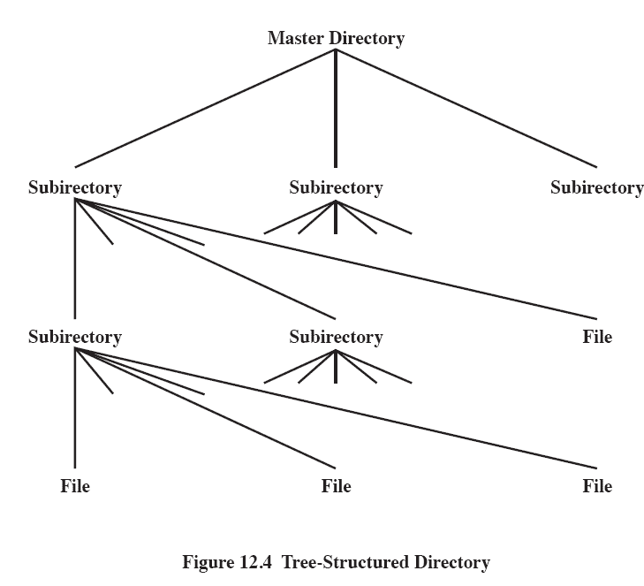
Figure 12.4 Tree-Structured Directory
Master directory with user directories underneath it
Each user directory may have subdirectories and files as entries
Notes:
A more powerful and flexible approach, and one that is almost universally
adopted, is the hierarchical, or tree-structure, approach ( Figure 12.6 ). As before,
there is a master directory, which has under it a number of user directories. Each of
these user directories, in turn, may have subdirectories and files as entries. This is
true at any level: That is, at any level, a directory may consist of entries for subdirectories
and/or entries for files.
It remains to say how each directory and subdirectory is organized. The simplest
approach, of course, is to store each directory as a sequential file. When directories
may contain a very large number of entries, such an organization may lead to unnecessarily
long search times. In that case, a hashed structure is to be preferred.

Slide 48
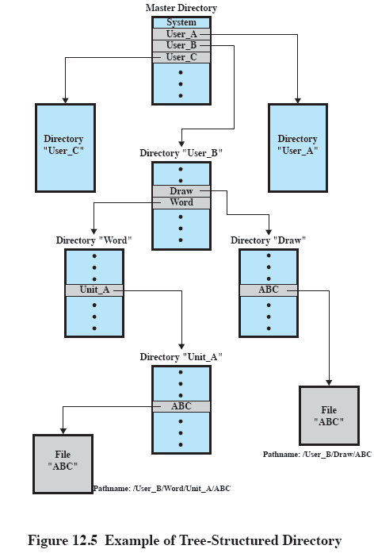
Example of Tree-Structured Directory
Notes:
Users need to be able to refer to a file by a symbolic name. Clearly, each file in the
system must have a unique name in order that file references be unambiguous. On
the other hand, it is an unacceptable burden on users to require that they provide
unique names, especially in a shared system.
The use of a tree-structured directory minimizes the difficulty in assigning
unique names. Any file in the system can be located by following a path from the
root or master directory down various branches until the file is reached. The series
of directory names, culminating in the file name itself, constitutes a pathname for
the file. As an example, the file in the lower left-hand corner of Figure 12.7 . has the
pathname User_B/Word/Unit_A/ABC . The slash is used to delimit names in the
sequence. The name of the master directory is implicit, because all paths start at
that directory. Note that it is perfectly acceptable to have several files with the same
file name, as long as they have unique pathnames, which is equivalent to saying
that the same file name may be used in different directories. In our example, there
is another file in the system with the file name ABC, but that has the pathname
/User_B/Draw/ABC .
Although the pathname facilitates the selection of file names, it would be awkward
for a user to have to spell out the entire pathname every time a reference is
made to a file. Typically, an interactive user or a process has associated with it a
current directory, often referred to as the working directory . Files are then referenced
relative to the working directory. For example, if the working directory for
user B is “Word,” then the pathname Unit_A/ABC is sufficient to identify the file
in the lower left-hand corner of Figure 12.7 . When an interactive user logs on, or
when a process is created, the default for the working directory is the user home
directory. During execution, the user can navigate up or down in the tree to change
to a different working directory.

Slide 49
File Sharing
Two issues arise when allowing files to be shared among a number of users:
access rights
management of simultaneous access
Notes:
In a multiuser system, there is almost always a requirement for allowing files to be
shared among a number of users. Two issues arise: access rights and the management
of simultaneous access.

Slide 50
Access Rights
None
the user would not be allowed to read the user directory that includes the file
Knowledge
the user can determine that the file exists and who its owner is and can then petition the owner for additional access rights
Execution
the user can load and execute a program but cannot copy it
Reading
the user can read the file for any purpose, including copying and execution
Appending
the user can add data to the file but cannot modify or delete any of the file’s contents
Updating
the user can modify, delete, and add to the file’s data
Changing protection
the user can change the access rights granted to other users
Deletion
the user can delete the file from the file system
Notes:
The file system should provide a flexible tool for allowing extensive file sharing
among users. The file system should provide a number of options so that the way
in which a particular file is accessed can be controlled. Typically, users or groups
of users are granted certain access rights to a file. A wide range of access rights has
been used. The following list is representative of access rights that can be assigned
to a particular user for a particular file:
• None: The user may not even learn of the existence of the file, much less
access it. To enforce this restriction, the user would not be allowed to read the
user directory that includes this file.
• Knowledge: The user can determine that the file exists and who its owner is.
The user is then able to petition the owner for additional access rights.
• Execution: The user can load and execute a program but cannot copy it.
Proprietary programs are often made accessible with this restriction.
• Reading: The user can read the file for any purpose, including copying and
execution. Some systems are able to enforce a distinction between viewing
and copying. In the former case, the contents of the file can be displayed to the
user, but the user has no means for making a copy.
• Appending: The user can add data to the file, often only at the end, but cannot
modify or delete any of the file’s contents. This right is useful in collecting data
from a number of sources.
• Updating: The user can modify, delete, and add to the file’s data. This normally
includes writing the file initially, rewriting it completely or in part, and removing
all or a portion of the data. Some systems distinguish among different
degrees of updating.
• Changing protection: The user can change the access rights granted to other
users. Typically, this right is held only by the owner of the file. In some systems,
the owner can extend this right to others. To prevent abuse of this mechanism,
the file owner will typically be able to specify which rights can be changed by
the holder of this right.
• Deletion: The user can delete the file from the file system.
These rights can be considered to constitute a hierarchy, with each right implying
those that precede it. Thus, if a particular user is granted the updating right for a
particular file, then that user is also granted the following rights: knowledge, execution,
reading, and appending.

Slide 51
User Access Rights
Owner
usually the initial creator of the file
has full rights
may grant rights to others
Specific Users
individual users who are designated by user ID
User Groups
a set of users who are not individually defined
All
all users who have access to this system
these are public files
Notes:
One user is designated as owner of a given file, usually the person who initially
created a file. The owner has all of the access rights listed previously and may grant
rights to others. Access can be provided to different classes of users:
• Specific user: Individual users who are designated by user ID
• User groups: A set of users who are not individually defined. The system must
have some way of keeping track of the membership of user groups.
• All: All users who have access to this system. These are public files.

Slide 52
Secondary Storage Management
On secondary storage, a file consists of a collection of blocks.
The operating system or file management system is responsible for allocating blocks to files.
This raises two management issues.
First, space on secondary storage must be allocated to files,
Second, it is necessary to keep track of the space available for allocation.
Notes:
On secondary storage, a file consists of a collection of blocks. The operating system
or file management system is responsible for allocating blocks to files. This raises
two management issues. First, space on secondary storage must be allocated to files,
and second, it is necessary to keep track of the space available for allocation. We
will see that these two tasks are related; that is, the approach taken for file allocation
may influence the approach taken for free space management. Further, we will
see that there is an interaction between file structure and allocation policy.
We begin this section by looking at alternatives for file allocation on a single
disk. Then we look at the issue of free space management, and finally we discuss
reliability.
File Allocation
Several issues are involved in file allocation:
1. When a new file is created, is the maximum space required for the file allocated
at once?
2. Space is allocated to a file as one or more contiguous units, which we shall
refer to as portions. That is, a portion is a contiguous set of allocated blocks.
The size of a portion can range from a single block to the entire file. What size
of portion should be used for file allocation?
3. What sort of data structure or table is used to keep track of the portions
assigned to a file? An example of such a structure is a file allocation table
(FAT) , found on DOS and some other systems.

Slide 53
File Allocation
Disks are divided into physical blocks (sectors on a track)
Files are divided into logical blocks (subdivisions of the file)
Logical block size = some multiple of a physical block size
Notes:
On secondary storage, a file consists of a collection of blocks. The operating system
or file management system is responsible for allocating blocks to files. This raises
two management issues. First, space on secondary storage must be allocated to files,
and second, it is necessary to keep track of the space available for allocation. We
will see that these two tasks are related; that is, the approach taken for file allocation
may influence the approach taken for free space management. Further, we will
see that there is an interaction between file structure and allocation policy.
We begin this section by looking at alternatives for file allocation on a single
disk. Then we look at the issue of free space management, and finally we discuss
reliability.
File Allocation
Several issues are involved in file allocation:
1. When a new file is created, is the maximum space required for the file allocated
at once?
2. Space is allocated to a file as one or more contiguous units, which we shall
refer to as portions. That is, a portion is a contiguous set of allocated blocks.
The size of a portion can range from a single block to the entire file. What size
of portion should be used for file allocation?
3. What sort of data structure or table is used to keep track of the portions
assigned to a file? An example of such a structure is a file allocation table
(FAT) , found on DOS and some other systems.

Slide 54
File Allocation
The operating system or file management system is responsible for allocating blocks to files
Space is allocated to a file as one or more portions (contiguous set of allocated disk blocks). A portion is the logical block size
File allocation table (FAT)
data structure used to keep track of the portions assigned to a file
Notes:
On secondary storage, a file consists of a collection of blocks. The operating system
or file management system is responsible for allocating blocks to files. This raises
two management issues. First, space on secondary storage must be allocated to files,
and second, it is necessary to keep track of the space available for allocation. We
will see that these two tasks are related; that is, the approach taken for file allocation
may influence the approach taken for free space management. Further, we will
see that there is an interaction between file structure and allocation policy.
We begin this section by looking at alternatives for file allocation on a single
disk. Then we look at the issue of free space management, and finally we discuss
reliability.
File Allocation
Several issues are involved in file allocation:
1. When a new file is created, is the maximum space required for the file allocated
at once?
2. Space is allocated to a file as one or more contiguous units, which we shall
refer to as portions. That is, a portion is a contiguous set of allocated blocks.
The size of a portion can range from a single block to the entire file. What size
of portion should be used for file allocation?
3. What sort of data structure or table is used to keep track of the portions
assigned to a file? An example of such a structure is a file allocation table
(FAT) , found on DOS and some other systems.

Slide 55
Preallocation vs Dynamic Allocation
A preallocation policy requires that the maximum size of a file be declared at the time of the file creation request
For many applications it is difficult to estimate reliably the maximum potential size of the file
tends to be wasteful because users and application programmers tend to overestimate size
Dynamic allocation allocates space to a file in portions as needed
Notes:
A preallocation policy requires
that the maximum size of a file be declared at the time of the file creation request.
In a number of cases, such as program compilations, the production of summary
data files, or the transfer of a file from another system over a communications
network, this value can be reliably estimated. However, for many applications, it
is difficult if not impossible to estimate reliably the maximum potential size of the
file. In those cases, users and application programmers would tend to overestimate
file size so as not to run out of space. This clearly is wasteful from the point of view
of secondary storage allocation. Thus, there are advantages to the use of dynamic
allocation, which allocates space to a file in portions as needed.

Slide 56

Portion Size
In choosing a portion size there is a trade-off between efficiency from the point of view of a single file versus overall system efficiency
Items to be considered:
contiguity of space increases performance, especially for Retrieve_Next operations, and greatly for transactions running in a transaction-oriented operating system
having a large number of small portions increases the size of tables needed to manage the allocation information
having fixed-size portions simplifies the reallocation of space
having variable-size or small fixed-size portions minimizes waste of unused storage due to overallocation
Notes:
The second issue listed is that of the size of the portion allocated to a
file. At one extreme, a portion large enough to hold the entire file is allocated. At the
other extreme, space on the disk is allocated one block at a time. In choosing a portion
size, there is a trade-off between efficiency from the point of view of a single file versus
overall system efficiency. [WIED87] lists four items to be considered in the trade-off:
1. Contiguity of space increases performance, especially for Retrieve_Next
operations, and greatly for transactions running in a transaction-oriented
operating system.
2. Having a large number of small portions increases the size of tables needed to
manage the allocation information.
3. Having fixed-size portions (e.g., blocks) simplifies the reallocation of space.
4. Having variable-size or small fixed-size portions minimizes waste of unused
storage due to overallocation.

Slide 57
Summarizing the Alternatives
Two major alternatives:
Variable, large contiguous portions
Blocks
provides better performance
the variable size avoids waste
the file allocation tables are small
small fixed portions provide greater flexibility
they may require large tables or complex structures for their allocation
contiguity has been abandoned as a primary goal
blocks are allocated as needed
Notes:
Of course, these items interact and must be considered together. The result is
that there are two major alternatives:
• Variable, large contiguous portions: This will provide better performance. The
variable size avoids waste, and the file allocation tables are small. However,
space is hard to reuse.
• Blocks : Small fixed portions provide greater flexibility. They may require
large tables or complex structures for their allocation. Contiguity has been
abandoned as a primary goal; blocks are allocated as needed.
Either option is compatible with preallocation or dynamic allocation. In
the case of variable, large contiguous portions, a file is preallocated one contiguous
group of blocks. This eliminates the need for a file allocation table; all that is
required is a pointer to the first block and the number of blocks allocated. In the
case of blocks, all of the portions required are allocated at one time. This means that
the file allocation table for the file will remain of fixed size, because the number of
blocks allocated is fixed.
With variable-size portions, we need to be concerned with the fragmentation
of free space. This issue was faced when we considered partitioned main memory in
Chapter 7 . The following are possible alternative strategies:
• First fit: Choose the first unused contiguous group of blocks of sufficient size
from a free block list.
• Best fit: Choose the smallest unused group that is of sufficient size.
• Nearest fit: Choose the unused group of sufficient size that is closest to the
previous allocation for the file to increase locality.
It is not clear which strategy is best. The difficulty in modeling alternative
strategies is that so many factors interact, including types of files, pattern of file
access, degree of multiprogramming, other performance factors in the system, disk
caching, disk scheduling, and so on.

Slide 58
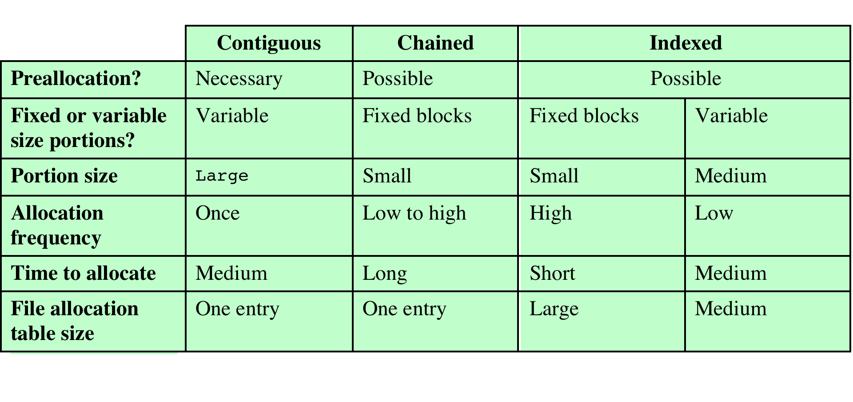
Table 12.3 File Allocation Methods
Notes:
Table 12.3 File Allocation Methods
Having looked at the issues of preallocation versus
dynamic allocation and portion size, we are in a position to consider specific file
allocation methods. Three methods are in common use: contiguous, chained, and
indexed. Table 12.3 summarizes some of the characteristics of each method.

Slide 59
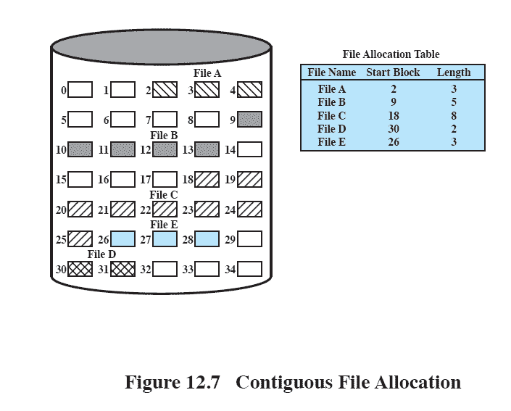
Contiguous File Allocation
A single contiguous set of blocks is allocated to a file at the time of file creation
Thus, this is a preallocation strategy,
Preallocation strategy using variable-size portions
12.9
Notes:
With contiguous allocation , a single contiguous set of blocks is allocated to a
file at the time of file creation ( Figure 12.9 ). Thus, this is a preallocation strategy,
using variable-size portions. The file allocation table needs just a single entry for
each file, showing the starting block and the length of the file. Contiguous allocation
is the best from the point of view of the individual sequential file. Multiple blocks
can be read in at a time to improve I/O performance for sequential processing. It is
also easy to retrieve a single block. For example, if a file starts at block b , and the
i th block of the file is wanted, its location on secondary storage is simply b + i – 1.
Contiguous allocation presents some problems. External fragmentation will occur,
making it difficult to find contiguous blocks of space of sufficient length.

Slide 60
Contiguous File Allocation
The file allocation table needs just a single entry for each file,
showing the starting block and the length of the file.
12.9
Notes:
With contiguous allocation , a single contiguous set of blocks is allocated to a
file at the time of file creation ( Figure 12.9 ). Thus, this is a preallocation strategy,
using variable-size portions. The file allocation table needs just a single entry for
each file, showing the starting block and the length of the file. Contiguous allocation
is the best from the point of view of the individual sequential file. Multiple blocks
can be read in at a time to improve I/O performance for sequential processing. It is
also easy to retrieve a single block. For example, if a file starts at block b , and the
i th block of the file is wanted, its location on secondary storage is simply b + i – 1.
Contiguous allocation presents some problems. External fragmentation will occur,
making it difficult to find contiguous blocks of space of sufficient length.

Slide 61
Contiguous File Allocation
Contiguous allocation is the best from the point of view of the individual sequential file.
Multiple blocks can be read in at a time to improve I/O performance for sequential processing.
It is also easy to retrieve a single block.
For example, if a file starts at block b , and the i th block of the file is wanted, its location on secondary storage is simply b + i – 1.
12.9
Notes:
With contiguous allocation , a single contiguous set of blocks is allocated to a
file at the time of file creation ( Figure 12.9 ). Thus, this is a preallocation strategy,
using variable-size portions. The file allocation table needs just a single entry for
each file, showing the starting block and the length of the file. Contiguous allocation
is the best from the point of view of the individual sequential file. Multiple blocks
can be read in at a time to improve I/O performance for sequential processing. It is
also easy to retrieve a single block. For example, if a file starts at block b , and the
i th block of the file is wanted, its location on secondary storage is simply b + i – 1.
Contiguous allocation presents some problems. External fragmentation will occur,
making it difficult to find contiguous blocks of space of sufficient length.

Slide 62
Contiguous File Allocation
Contiguous allocation presents some problems?
12.9
Notes:
With contiguous allocation , a single contiguous set of blocks is allocated to a
file at the time of file creation ( Figure 12.9 ). Thus, this is a preallocation strategy,
using variable-size portions. The file allocation table needs just a single entry for
each file, showing the starting block and the length of the file. Contiguous allocation
is the best from the point of view of the individual sequential file. Multiple blocks
can be read in at a time to improve I/O performance for sequential processing. It is
also easy to retrieve a single block. For example, if a file starts at block b , and the
i th block of the file is wanted, its location on secondary storage is simply b + i – 1.
Contiguous allocation presents some problems. External fragmentation will occur,
making it difficult to find contiguous blocks of space of sufficient length.

Slide 63
Contiguous File Allocation
External fragmentation will occur, making it difficult to find contiguous blocks of space of sufficient length.
Soln?
12.9
Notes:
With contiguous allocation , a single contiguous set of blocks is allocated to a
file at the time of file creation ( Figure 12.9 ). Thus, this is a preallocation strategy,
using variable-size portions. The file allocation table needs just a single entry for
each file, showing the starting block and the length of the file. Contiguous allocation
is the best from the point of view of the individual sequential file. Multiple blocks
can be read in at a time to improve I/O performance for sequential processing. It is
also easy to retrieve a single block. For example, if a file starts at block b , and the
i th block of the file is wanted, its location on secondary storage is simply b + i – 1.
Contiguous allocation presents some problems. External fragmentation will occur,
making it difficult to find contiguous blocks of space of sufficient length.

Slide 64
Contiguous File Allocation
Soln?
From time to time, it will be necessary to perform a compaction algorithm to free up additional space on the disk
12.9
Notes:
With contiguous allocation , a single contiguous set of blocks is allocated to a
file at the time of file creation ( Figure 12.9 ). Thus, this is a preallocation strategy,
using variable-size portions. The file allocation table needs just a single entry for
each file, showing the starting block and the length of the file. Contiguous allocation
is the best from the point of view of the individual sequential file. Multiple blocks
can be read in at a time to improve I/O performance for sequential processing. It is
also easy to retrieve a single block. For example, if a file starts at block b , and the
i th block of the file is wanted, its location on secondary storage is simply b + i – 1.
Contiguous allocation presents some problems. External fragmentation will occur,
making it difficult to find contiguous blocks of space of sufficient length.

Slide 65
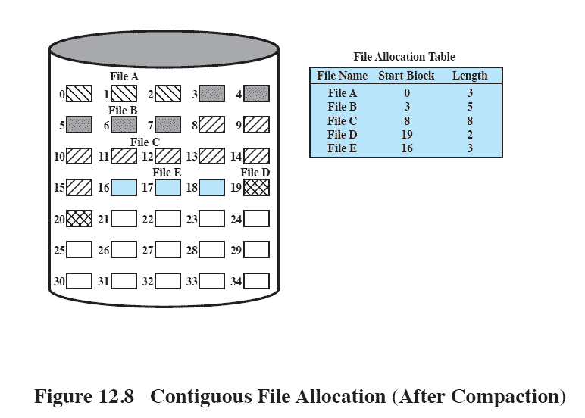
After Compaction
Figure 12.10 Contiguous File Allocation (After Compaction)
Notes:
From time to time, it will be necessary to perform a compaction algorithm to free up additional
space on the disk ( Figure 12.10 ). Also, with preallocation, it is necessary to declare
the size of the file at the time of creation, with the problems mentioned earlier.

Slide 66
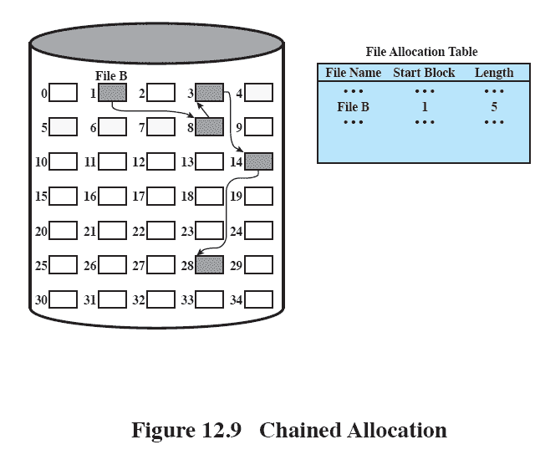
Chained Allocation
Allocation is on an individual block basis
Each block contains a pointer to the next block in the chain
The file allocation table needs just a single entry for each file.
showing the starting block and the length of the file.
12.11
Notes:
At the opposite extreme from contiguous allocation is chained allocation
( Figure 12.11 ). Typically, allocation is on an individual block basis. Each block contains
a pointer to the next block in the chain. Again, the file allocation table needs
just a single entry for each file, showing the starting block and the length of the
file. Although preallocation is possible, it is more common simply to allocate blocks
as needed. The selection of blocks is now a simple matter: Any free block can be
added to a chain. There is no external fragmentation to worry about because only
one block at a time is needed. This type of physical organization is best suited to
sequential files that are to be processed sequentially. To select an individual block
of a file requires tracing through the chain to the desired block.

Slide 67
Chained Allocation
Although preallocation is possible,
it is more common simply to allocate blocks as needed.
The selection of blocks is now a simple matter:
Any free block can be added to a chain.
12.11
Notes:
At the opposite extreme from contiguous allocation is chained allocation
( Figure 12.11 ). Typically, allocation is on an individual block basis. Each block contains
a pointer to the next block in the chain. Again, the file allocation table needs
just a single entry for each file, showing the starting block and the length of the
file. Although preallocation is possible, it is more common simply to allocate blocks
as needed. The selection of blocks is now a simple matter: Any free block can be
added to a chain. There is no external fragmentation to worry about because only
one block at a time is needed. This type of physical organization is best suited to
sequential files that are to be processed sequentially. To select an individual block
of a file requires tracing through the chain to the desired block.

Slide 68
Chained Allocation
There is no external fragmentation to worry about because only one block at a time is needed
Better for sequential files
12.11
Notes:
At the opposite extreme from contiguous allocation is chained allocation
( Figure 12.11 ). Typically, allocation is on an individual block basis. Each block contains
a pointer to the next block in the chain. Again, the file allocation table needs
just a single entry for each file, showing the starting block and the length of the
file. Although preallocation is possible, it is more common simply to allocate blocks
as needed. The selection of blocks is now a simple matter: Any free block can be
added to a chain. There is no external fragmentation to worry about because only
one block at a time is needed. This type of physical organization is best suited to
sequential files that are to be processed sequentially. To select an individual block
of a file requires tracing through the chain to the desired block.

Slide 69
Chained Allocation
One consequence of chaining, as described so far, is that there is no accommodation of the principle of locality.
To overcome this problem
Some systems periodically consolidate files
12.11
Notes:
At the opposite extreme from contiguous allocation is chained allocation
( Figure 12.11 ). Typically, allocation is on an individual block basis. Each block contains
a pointer to the next block in the chain. Again, the file allocation table needs
just a single entry for each file, showing the starting block and the length of the
file. Although preallocation is possible, it is more common simply to allocate blocks
as needed. The selection of blocks is now a simple matter: Any free block can be
added to a chain. There is no external fragmentation to worry about because only
one block at a time is needed. This type of physical organization is best suited to
sequential files that are to be processed sequentially. To select an individual block
of a file requires tracing through the chain to the desired block.

Slide 70
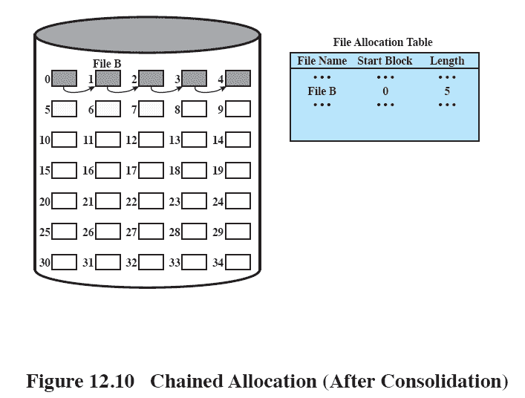
Chained Allocation After Consolidation
12.12
Notes:
One consequence of chaining, as described so far, is that there is no accommodation
of the principle of locality. Thus, if it is necessary to bring in several blocks of
a file at a time, as in sequential processing, then a series of accesses to different parts
of the disk are required. This is perhaps a more significant effect on a single-user
system but may also be of concern on a shared system. To overcome this problem,
some systems periodically consolidate files ( Figure 12.12 ).

Slide 71
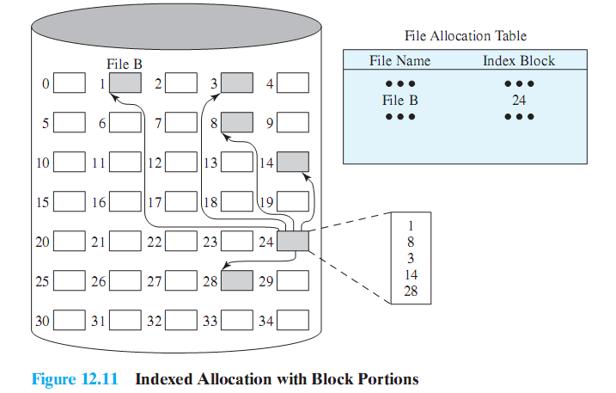
Indexed Allocation with Block Portions
12.13
Notes:
Indexed allocation addresses many of the problems of contiguous and chained
allocation. In this case, the file allocation table contains a separate one-level index for
each file; the index has one entry for each portion allocated to the file. Typically, the
file indexes are not physically stored as part of the file allocation table. Rather, the
file index for a file is kept in a separate block, and the entry for the file in the file allocation
table points to that block. Allocation may be on the basis of either fixed-size
blocks ( Figure 12.13 ) or variable-size portions ( Figure 12.14 ). Allocation by blocks
eliminates external fragmentation, whereas allocation by variable-size portions
improves locality. In either case, file consolidation may be done from time to time.
File consolidation reduces the size of the index in the case of variable-size portions,
but not in the case of block allocation. Indexed allocation supports both sequential
and direct access to the file and thus is the most popular form of file allocation.

Slide 72
Indexed Allocation with Block Portions
In this case, the file allocation table contains a separate one-level index for each file
The index has one entry for each portion allocated to the file.
File index for a file is kept in a separate block, and the entry for the file in the file allocation table points to that block
12.13
Notes:
Indexed allocation addresses many of the problems of contiguous and chained
allocation. In this case, the file allocation table contains a separate one-level index for
each file; the index has one entry for each portion allocated to the file. Typically, the
file indexes are not physically stored as part of the file allocation table. Rather, the
file index for a file is kept in a separate block, and the entry for the file in the file allocation
table points to that block. Allocation may be on the basis of either fixed-size
blocks ( Figure 12.13 ) or variable-size portions ( Figure 12.14 ). Allocation by blocks
eliminates external fragmentation, whereas allocation by variable-size portions
improves locality. In either case, file consolidation may be done from time to time.
File consolidation reduces the size of the index in the case of variable-size portions,
but not in the case of block allocation. Indexed allocation supports both sequential
and direct access to the file and thus is the most popular form of file allocation.

Slide 73
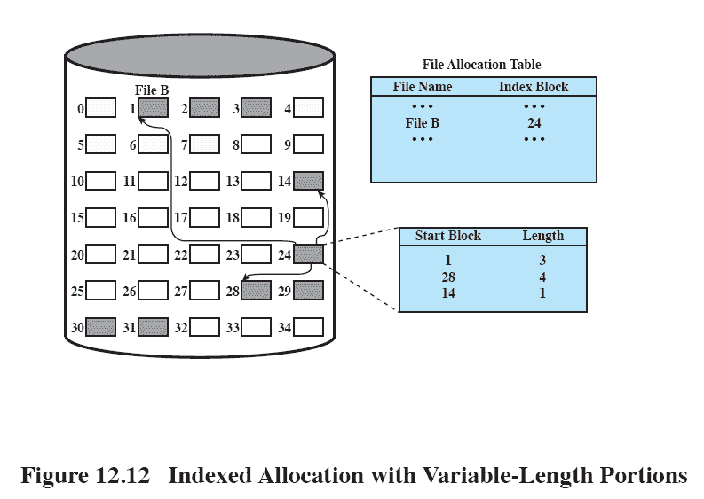
Indexed Allocation with Variable Length Portions
12.14
Notes:
Figure 12.14 Indexed allocation with Variable-Length Portions

Slide 74
Free Space Management
Just as allocated space must be managed, so must the unallocated space
To perform file allocation, it is necessary to know which blocks are available
A disk allocation table is needed in addition to a file allocation table
Notes:
Just as the space that is allocated to files must be managed, so the space that is not
currently allocated to any file must be managed. To perform any of the file allocation
techniques described previously, it is necessary to know what blocks on the disk
are available. Thus we need a disk allocation table in addition to a file allocation
table. We discuss here a number of techniques that have been implemented.

Slide 75
Bit Tables (Bit Vectors)
This method uses a vector containing one bit for each block on the disk
Each entry of a 0 corresponds to a free block,
Each 1 corresponds to a block in use
Advantages:
works well with any file allocation method
it is as small as possible
Notes:
This method uses a vector containing one bit for each block on the
disk. Each entry of a 0 corresponds to a free block, and each 1 corresponds to a
block in use. For example, for the disk layout of Figure 12.9 , a vector of length 35 is
needed and would have the following value:
00111000011111000011111111111011000
A bit table has the advantage that it is relatively easy to find one or a contiguous
group of free blocks. Thus, a bit table works well with any of the file
allocation methods outlined. Another advantage is that it is as small as possible.
However, it can still be sizable. The amount of memory (in bytes) required for a
block bitmap is
disk size in bytes/
8 * file system block size
Thus, for a 16-Gbyte disk with 512-byte blocks, the bit table occupies about
4 Mbytes. Can we spare 4 Mbytes of main memory for the bit table? If so, then the
bit table can be searched without the need for disk access. But even with today’s
memory sizes, 4 Mbytes is a hefty chunk of main memory to devote to a single function.
The alternative is to put the bit table on disk. But a 4-Mbyte bit table would
require about 8,000 disk blocks. We can’t afford to search that amount of disk space
every time a block is needed, so a bit table resident in memory is indicated.
Even when the bit table is in main memory, an exhaustive search of the table
can slow file system performance to an unacceptable degree. This is especially true
when the disk is nearly full and there are few free blocks remaining. Accordingly,
most file systems that use bit tables maintain auxiliary data structures that summarize
the contents of subranges of the bit table. For example, the table could be
divided logically into a number of equal-size subranges. A summary table could
include, for each subrange, the number of free blocks and the maximum-sized contiguous
number of free blocks. When the file system needs a number of contiguous
blocks, it can scan the summary table to find an appropriate subrange and then
search that subrange.

Slide 76
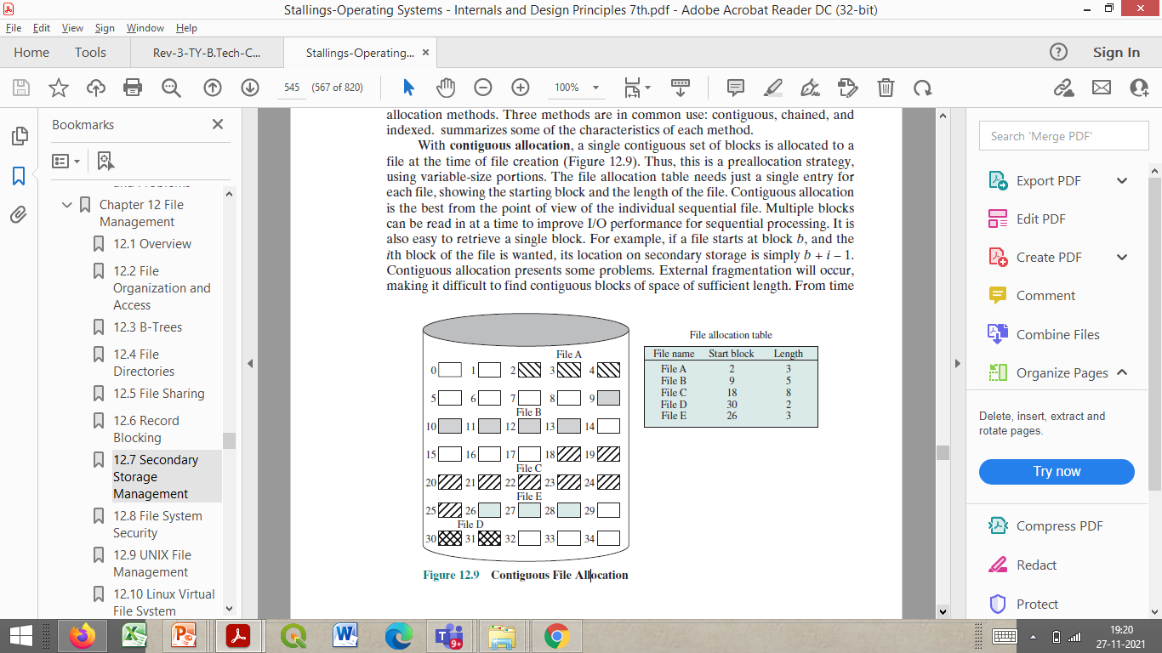
Bit Tables (Bit Vectors)
For the disk layout of Figure 12.9 , A vector of length 35 is needed and would have the following value:
00111000011111000011111111111011000
Notes:
This method uses a vector containing one bit for each block on the
disk. Each entry of a 0 corresponds to a free block, and each 1 corresponds to a
block in use. For example, for the disk layout of Figure 12.9 , a vector of length 35 is
needed and would have the following value:
00111000011111000011111111111011000
A bit table has the advantage that it is relatively easy to find one or a contiguous
group of free blocks. Thus, a bit table works well with any of the file
allocation methods outlined. Another advantage is that it is as small as possible.
However, it can still be sizable. The amount of memory (in bytes) required for a
block bitmap is
disk size in bytes/
8 * file system block size
Thus, for a 16-Gbyte disk with 512-byte blocks, the bit table occupies about
4 Mbytes. Can we spare 4 Mbytes of main memory for the bit table? If so, then the
bit table can be searched without the need for disk access. But even with today’s
memory sizes, 4 Mbytes is a hefty chunk of main memory to devote to a single function.
The alternative is to put the bit table on disk. But a 4-Mbyte bit table would
require about 8,000 disk blocks. We can’t afford to search that amount of disk space
every time a block is needed, so a bit table resident in memory is indicated.
Even when the bit table is in main memory, an exhaustive search of the table
can slow file system performance to an unacceptable degree. This is especially true
when the disk is nearly full and there are few free blocks remaining. Accordingly,
most file systems that use bit tables maintain auxiliary data structures that summarize
the contents of subranges of the bit table. For example, the table could be
divided logically into a number of equal-size subranges. A summary table could
include, for each subrange, the number of free blocks and the maximum-sized contiguous
number of free blocks. When the file system needs a number of contiguous
blocks, it can scan the summary table to find an appropriate subrange and then
search that subrange.

Slide 77
Bit Tables (Bit Vectors)
Advantages:
relatively easy to find one or a contiguous group of free blocks.
it is as small as possible
works well with any file allocation method
Notes:
This method uses a vector containing one bit for each block on the
disk. Each entry of a 0 corresponds to a free block, and each 1 corresponds to a
block in use. For example, for the disk layout of Figure 12.9 , a vector of length 35 is
needed and would have the following value:
00111000011111000011111111111011000
A bit table has the advantage that it is relatively easy to find one or a contiguous
group of free blocks. Thus, a bit table works well with any of the file
allocation methods outlined. Another advantage is that it is as small as possible.
However, it can still be sizable. The amount of memory (in bytes) required for a
block bitmap is
disk size in bytes/
8 * file system block size
Thus, for a 16-Gbyte disk with 512-byte blocks, the bit table occupies about
4 Mbytes. Can we spare 4 Mbytes of main memory for the bit table? If so, then the
bit table can be searched without the need for disk access. But even with today’s
memory sizes, 4 Mbytes is a hefty chunk of main memory to devote to a single function.
The alternative is to put the bit table on disk. But a 4-Mbyte bit table would
require about 8,000 disk blocks. We can’t afford to search that amount of disk space
every time a block is needed, so a bit table resident in memory is indicated.
Even when the bit table is in main memory, an exhaustive search of the table
can slow file system performance to an unacceptable degree. This is especially true
when the disk is nearly full and there are few free blocks remaining. Accordingly,
most file systems that use bit tables maintain auxiliary data structures that summarize
the contents of subranges of the bit table. For example, the table could be
divided logically into a number of equal-size subranges. A summary table could
include, for each subrange, the number of free blocks and the maximum-sized contiguous
number of free blocks. When the file system needs a number of contiguous
blocks, it can scan the summary table to find an appropriate subrange and then
search that subrange.

Slide 78
Chained Free Portions
The free portions may be chained together by using a pointer and length value in each free portion
Negligible space overhead because there is no need for a disk allocation table, merely for a pointer to the beginning of the chain and the length of the first portion.
Suited to all file allocation methods
Notes:
The free portions may be chained together by using
a pointer and length value in each free portion. This method has negligible space
overhead because there is no need for a disk allocation table, merely for a pointer to
the beginning of the chain and the length of the first portion. This method is suited
to all of the file allocation methods. If allocation is a block at a time, simply choose
the free block at the head of the chain and adjust the first pointer or length value.
If allocation is by variable-length portion, a first-fit algorithm may be used: The
headers from the portions are fetched one at a time to determine the next suitable
free portion in the chain. Again, pointer and length values are adjusted.
This method has its own problems. After some use, the disk will become quite
fragmented and many portions will be a single block long. Also note that every
time you allocate a block, you need to read the block first to recover the pointer to
the new first free block before writing data to that block. If many individual blocks
need to be allocated at one time for a file operation, this greatly slows file creation.
Similarly, deleting highly fragmented files is very time consuming.

Slide 79
Chained Free Portions
If allocation is a block at a time, simply choose the free block at the head of the chain and adjust the first pointer or length value.
If allocation is by variable-length portion, a first-fit algorithm may be used:
The headers from the portions are fetched one at a time to determine the next suitable free portion in the chain.
Again, pointer and length values are adjusted.
Notes:
The free portions may be chained together by using
a pointer and length value in each free portion. This method has negligible space
overhead because there is no need for a disk allocation table, merely for a pointer to
the beginning of the chain and the length of the first portion. This method is suited
to all of the file allocation methods. If allocation is a block at a time, simply choose
the free block at the head of the chain and adjust the first pointer or length value.
If allocation is by variable-length portion, a first-fit algorithm may be used: The
headers from the portions are fetched one at a time to determine the next suitable
free portion in the chain. Again, pointer and length values are adjusted.
This method has its own problems. After some use, the disk will become quite
fragmented and many portions will be a single block long. Also note that every
time you allocate a block, you need to read the block first to recover the pointer to
the new first free block before writing data to that block. If many individual blocks
need to be allocated at one time for a file operation, this greatly slows file creation.
Similarly, deleting highly fragmented files is very time consuming.

Slide 80
Chained Free Portions
Negligible space overhead because there is no need for a disk allocation table, merely for a pointer to the beginning of the chain and the length of the first portion.
Suited to all file allocation methods
Disadvantages:
leads to fragmentation
every time you allocate a block you need to read the block first to recover the pointer to the new first free block before writing data to that block
Notes:
The free portions may be chained together by using
a pointer and length value in each free portion. This method has negligible space
overhead because there is no need for a disk allocation table, merely for a pointer to
the beginning of the chain and the length of the first portion. This method is suited
to all of the file allocation methods. If allocation is a block at a time, simply choose
the free block at the head of the chain and adjust the first pointer or length value.
If allocation is by variable-length portion, a first-fit algorithm may be used: The
headers from the portions are fetched one at a time to determine the next suitable
free portion in the chain. Again, pointer and length values are adjusted.
This method has its own problems. After some use, the disk will become quite
fragmented and many portions will be a single block long. Also note that every
time you allocate a block, you need to read the block first to recover the pointer to
the new first free block before writing data to that block. If many individual blocks
need to be allocated at one time for a file operation, this greatly slows file creation.
Similarly, deleting highly fragmented files is very time consuming.

Slide 81
Indexing
Treats free space as a file and uses an index table as it would for file allocation
Notes:
The indexing approach treats free space as a file and uses an index table
as described under file allocation. For efficiency, the index should be on the basis
of variable-size portions rather than blocks. Thus, there is one entry in the table for
every free portion on the disk. This approach provides efficient support for all of
the file allocation methods.

Slide 82
Indexing
For efficiency, the index should be on the basis of variable-size portions rather than blocks
This approach provides efficient support for all of the file allocation methods
Notes:
The indexing approach treats free space as a file and uses an index table
as described under file allocation. For efficiency, the index should be on the basis
of variable-size portions rather than blocks. Thus, there is one entry in the table for
every free portion on the disk. This approach provides efficient support for all of
the file allocation methods.

Slide 83
Free Block List
Each block is assigned a number sequentially
the list of the numbers of all free blocks is maintained in a reserved portion of the disk
Depending on the size of the disk, either 24 or 32 bits will be needed to store a single block number
the size of the free block list is 24 or 32 times the size of the corresponding bit table and must be stored on disk
Notes:
In this method, each block is assigned a number sequentially
and the list of the numbers of all free blocks is maintained in a reserved portion of
the disk. Depending on the size of the disk, either 24 or 32 bits will be needed to
store a single block number, so the size of the free block list is 24 or 32 times the size
of the corresponding bit table and thus must be stored on disk rather than in main
memory. However, this is a satisfactory method.
Consider the following points:
1. The space on disk devoted to the free block list is less than 1% of the total disk
space. If a 32-bit block number is used, then the space penalty is 4 bytes for
every 512-byte block.
2. Although the free block list is too large to store in main memory, there are
two effective techniques for storing a small part of the list in main memory.
a. The list can be treated as a push-down stack (Appendix 1B) with the first
few thousand elements of the stack kept in main memory. When a new
block is allocated, it is popped from the top of the stack, which is in main
memory. Similarly, when a block is deallocated, it is pushed onto the stack.
There only has to be a transfer between disk and main memory when the
in-memory portion of the stack becomes either full or empty. Thus, this
technique gives almost zero-time access most of the time.
b. The list can be treated as a FIFO queue, with a few thousand entries from
both the head and the tail of the queue in main memory. A block is allocated
by taking the first entry from the head of the queue and deallocated
by adding it to the end of the tail of the queue. There only has to be a transfer
between disk and main memory when either the in-memory portion of
the head of the queue becomes empty or the in-memory portion of the tail
of the queue becomes full.
In either of the strategies listed in the preceding point (stack or FIFO queue),
a background thread can slowly sort the in-memory list or lists to facilitate contiguous
allocation.

Slide 84
Free Block List
As the free block list is too large to store in main memory,
Free Block List must be stored on disk rather than in main memory.
There are two effective techniques for storing a small part of the list in main memory.
There are two effective techniques for storing a small part of the free block list in main memory:
the list can be treated as a push-down stack with the first few thousand elements of the stack kept in main memory
the list can be treated as a FIFO queue, with a few thousand entries from both the head and the tail of the queue in main memory

Slide 85
Free Block List
Stack-
When a new block is allocated, it is popped from the top of the stack, which is in main memory.
Similarly, when a block is deallocated, it is pushed onto the stack.
There are two effective techniques for storing a small part of the free block list in main memory:
the list can be treated as a push-down stack with the first few thousand elements of the stack kept in main memory
the list can be treated as a FIFO queue, with a few thousand entries from both the head and the tail of the queue in main memory

Slide 86
Free Block List
Stack-
There only has to be a transfer between disk and main memory when
the in-memory portion of the stack becomes either full or empty.
There are two effective techniques for storing a small part of the free block list in main memory:
the list can be treated as a push-down stack with the first few thousand elements of the stack kept in main memory
the list can be treated as a FIFO queue, with a few thousand entries from both the head and the tail of the queue in main memory

Slide 87
Free Block List
Queue-
A block is allocated by taking the first entry from the head of the queue and
deallocated by adding it to the end of the tail of the queue.
There are two effective techniques for storing a small part of the free block list in main memory:
the list can be treated as a push-down stack with the first few thousand elements of the stack kept in main memory
the list can be treated as a FIFO queue, with a few thousand entries from both the head and the tail of the queue in main memory

Slide 88
Free Block List
Queue-
There only has to be a transfer between disk and main memory
when either the in-memory portion of the head of the queue becomes empty or
the in-memory portion of the tail of the queue becomes full.
There are two effective techniques for storing a small part of the free block list in main memory:
the list can be treated as a push-down stack with the first few thousand elements of the stack kept in main memory
the list can be treated as a FIFO queue, with a few thousand entries from both the head and the tail of the queue in main memory

Slide 89
Review
File systems can support files organized as a sequence of bytes or as a sequence of records
Access methods depend on file organization
Disk storage of files can be contiguous, linked or indexed
Logical blocks of a file are mapped to one or more disk sectors to create physical blocks.
File Allocation Tables map files to disk locations

Slide 90
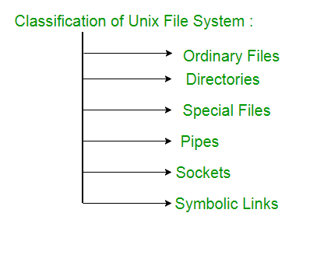
UNIX File Management

Slide 91
UNIX File Management
In the UNIX file system, six types of files are distinguished:
Regular, or Ordinary
Regular files contain information entered in them by a user, an application program, or a system utility program.
An ordinary file is a file on the system that contains data, text, or program instructions.
Notes:
Regular, or ordinary: Contains arbitrary data in zero or more data blocks.
Regular files contain information entered in them by a user, an application program, or a system utility program.
The file system does not impose any internal structure to a regular file but treats it as a stream of bytes.
Directory: Contains a list of file names plus pointers to associated inodes (index nodes)
Directories are hierarchically organized
Directory files are actually ordinary files with special write protection privileges so that only the file system can write into them, while read access is available to user programs.
Special: Contains no data, but provides a mechanism to map physical devices to file names.
The file names are used to access peripheral devices, such as terminals and printers.
Each I/O device is associated with a special file.
Named pipes: A pipe is an interprocess communications facility.
A pipe file buffers data received in its input so that a process that reads from the pipe’s output receives the data on a first-in-first-out basis.
Links: A link is an alternative file name for an existing file.
Symbolic links: This is a data file that contains the name of the file it is linked to.

Slide 92
UNIX File Management
In the UNIX file system, six types of files are distinguished:
Regular, or Ordinary
contains arbitrary data in zero or more data blocks
The file system does not impose any internal structure to a regular file but treats it as a stream of bytes.
Notes:
Regular, or ordinary: Contains arbitrary data in zero or more data blocks.
Regular files contain information entered in them by a user, an application program, or a system utility program.
The file system does not impose any internal structure to a regular file but treats it as a stream of bytes.
Directory: Contains a list of file names plus pointers to associated inodes (index nodes)
Directories are hierarchically organized
Directory files are actually ordinary files with special write protection privileges so that only the file system can write into them, while read access is available to user programs.
Special: Contains no data, but provides a mechanism to map physical devices to file names.
The file names are used to access peripheral devices, such as terminals and printers.
Each I/O device is associated with a special file.
Named pipes: A pipe is an interprocess communications facility.
A pipe file buffers data received in its input so that a process that reads from the pipe’s output receives the data on a first-in-first-out basis.
Links: A link is an alternative file name for an existing file.
Symbolic links: This is a data file that contains the name of the file it is linked to.

Slide 93
UNIX File Management
In the UNIX file system, six types of files are distinguished:
Directory
contains a list of file names plus pointers to associated inodes (index nodes)
Directories are hierarchically organized
Notes:
Regular, or ordinary: Contains arbitrary data in zero or more data blocks.
Regular files contain information entered in them by a user, an application program, or a system utility program.
The file system does not impose any internal structure to a regular file but treats it as a stream of bytes.
Directory: Contains a list of file names plus pointers to associated inodes (index nodes)
Directories are hierarchically organized
Directory files are actually ordinary files with special write protection privileges so that only the file system can write into them, while read access is available to user programs.
Special: Contains no data, but provides a mechanism to map physical devices to file names.
The file names are used to access peripheral devices, such as terminals and printers.
Each I/O device is associated with a special file.
Named pipes: A pipe is an interprocess communications facility.
A pipe file buffers data received in its input so that a process that reads from the pipe’s output receives the data on a first-in-first-out basis.
Links: A link is an alternative file name for an existing file.
Symbolic links: This is a data file that contains the name of the file it is linked to.

Slide 94
UNIX File Management
In the UNIX file system, six types of files are distinguished:
Special
Contains no data but provides a mechanism to map physical devices to file names.
These file names are used to access peripheral devices, such as terminals and printers.
Each I/O device is associated with a special file,
Notes:
Regular, or ordinary: Contains arbitrary data in zero or more data blocks.
Regular files contain information entered in them by a user, an application program, or a system utility program.
The file system does not impose any internal structure to a regular file but treats it as a stream of bytes.
Directory: Contains a list of file names plus pointers to associated inodes (index nodes)
Directories are hierarchically organized
Directory files are actually ordinary files with special write protection privileges so that only the file system can write into them, while read access is available to user programs.
Special: Contains no data, but provides a mechanism to map physical devices to file names.
The file names are used to access peripheral devices, such as terminals and printers.
Each I/O device is associated with a special file.
Named pipes: A pipe is an interprocess communications facility.
A pipe file buffers data received in its input so that a process that reads from the pipe’s output receives the data on a first-in-first-out basis.
Links: A link is an alternative file name for an existing file.
Symbolic links: This is a data file that contains the name of the file it is linked to.

Slide 95
UNIX File Management
In the UNIX file system, six types of files are distinguished:
Special
Used to represent a real physical device such as a printer, tape drive or terminal, used for Input/Output (I/O) operations.
Device or special files are used for device Input/Output(I/O) on UNIX and Linux systems.
Notes:
Regular, or ordinary: Contains arbitrary data in zero or more data blocks.
Regular files contain information entered in them by a user, an application program, or a system utility program.
The file system does not impose any internal structure to a regular file but treats it as a stream of bytes.
Directory: Contains a list of file names plus pointers to associated inodes (index nodes)
Directories are hierarchically organized
Directory files are actually ordinary files with special write protection privileges so that only the file system can write into them, while read access is available to user programs.
Special: Contains no data, but provides a mechanism to map physical devices to file names.
The file names are used to access peripheral devices, such as terminals and printers.
Each I/O device is associated with a special file.
Named pipes: A pipe is an interprocess communications facility.
A pipe file buffers data received in its input so that a process that reads from the pipe’s output receives the data on a first-in-first-out basis.
Links: A link is an alternative file name for an existing file.
Symbolic links: This is a data file that contains the name of the file it is linked to.

Slide 96
UNIX File Management
In the UNIX file system, six types of files are distinguished:
Named pipes
An interprocess communications facility
A pipe file buffers data received in its input
so that a process that reads from the pipe’s output receives the data on a first-in-first-out basis.
Notes:
Regular, or ordinary: Contains arbitrary data in zero or more data blocks.
Regular files contain information entered in them by a user, an application program, or a system utility program.
The file system does not impose any internal structure to a regular file but treats it as a stream of bytes.
Directory: Contains a list of file names plus pointers to associated inodes (index nodes)
Directories are hierarchically organized
Directory files are actually ordinary files with special write protection privileges so that only the file system can write into them, while read access is available to user programs.
Special: Contains no data, but provides a mechanism to map physical devices to file names.
The file names are used to access peripheral devices, such as terminals and printers.
Each I/O device is associated with a special file.
Named pipes: A pipe is an interprocess communications facility.
A pipe file buffers data received in its input so that a process that reads from the pipe’s output receives the data on a first-in-first-out basis.
Links: A link is an alternative file name for an existing file.
Symbolic links: This is a data file that contains the name of the file it is linked to.

Slide 97

A pipe is a section of shared memory that processes use for communication.
One process writes information to the pipe, then the other process reads the information from the pipe.

Slide 98
UNIX File Management
In the UNIX file system, six types of files are distinguished:
Sockets
Sockets – A Unix socket (or Inter-process communication socket) is a special file which allows for advanced inter-process communication.
A Unix Socket is used in a client-server application framework.
Notes:
Regular, or ordinary: Contains arbitrary data in zero or more data blocks.
Regular files contain information entered in them by a user, an application program, or a system utility program.
The file system does not impose any internal structure to a regular file but treats it as a stream of bytes.
Directory: Contains a list of file names plus pointers to associated inodes (index nodes)
Directories are hierarchically organized
Directory files are actually ordinary files with special write protection privileges so that only the file system can write into them, while read access is available to user programs.
Special: Contains no data, but provides a mechanism to map physical devices to file names.
The file names are used to access peripheral devices, such as terminals and printers.
Each I/O device is associated with a special file.
Named pipes: A pipe is an interprocess communications facility.
A pipe file buffers data received in its input so that a process that reads from the pipe’s output receives the data on a first-in-first-out basis.
Links: A link is an alternative file name for an existing file.
Symbolic links: This is a data file that contains the name of the file it is linked to.

Slide 99
UNIX File Management
In the UNIX file system, six types of files are distinguished:
Symbolic links
A data file that contains the name of the file it is linked to
Notes:
Regular, or ordinary: Contains arbitrary data in zero or more data blocks.
Regular files contain information entered in them by a user, an application program, or a system utility program.
The file system does not impose any internal structure to a regular file but treats it as a stream of bytes.
Directory: Contains a list of file names plus pointers to associated inodes (index nodes)
Directories are hierarchically organized
Directory files are actually ordinary files with special write protection privileges so that only the file system can write into them, while read access is available to user programs.
Special: Contains no data, but provides a mechanism to map physical devices to file names.
The file names are used to access peripheral devices, such as terminals and printers.
Each I/O device is associated with a special file.
Named pipes: A pipe is an interprocess communications facility.
A pipe file buffers data received in its input so that a process that reads from the pipe’s output receives the data on a first-in-first-out basis.
Links: A link is an alternative file name for an existing file.
Symbolic links: This is a data file that contains the name of the file it is linked to.

Slide 100
Symbolic link
Symbolic link is used for referencing some other file of the file system.
Symbolic link is also known as Soft link. It contains a text form of the path to the file it references.
To an end user, symbolic link will appear to have its own name, but when you try reading or writing data to this file, it will instead reference these operations to the file it points to.

Slide 101
Symbolic link
If we delete the soft link itself , the data file would still be there.If we delete the source file or move it to a different location, symbolic file will not function properly.
In long-format output of ls –l ,
Symbolic link are marked by the “l” symbol (that’s a lower case L).

Slide 102
UNIX File Management

Slide 103
How to Find Out these File Types in Linux
https://www.geeksforgeeks.org/how-to-find-out-file-types-in-linux/

Slide 104
Inodes
Modern UNIX operating systems support multiple file systems
but map all of these into a uniform underlying system for supporting file systems and allocating disk space to files.
All types of UNIX files are administered by the OS by means of inodes.
Notes:
Modern UNIX operating systems support multiple file systems but map all of these
into a uniform underlying system for supporting file systems and allocating disk
space to files. All types of UNIX files are administered by the OS by means of
inodes. An inode (index node) is a control structure that contains the key information
needed by the operating system for a particular file. Several file names may be
associated with a single inode, but an active inode is associated with exactly one file,
and each file is controlled by exactly one inode.

Slide 105
Inodes
The inode (index node) is a data structure in a Unix-style file system that describes a file-system object such as a file or a directory.
Each inode stores the attributes and disk block locations of the object's data
Notes:
Modern UNIX operating systems support multiple file systems but map all of these
into a uniform underlying system for supporting file systems and allocating disk
space to files. All types of UNIX files are administered by the OS by means of
inodes. An inode (index node) is a control structure that contains the key information
needed by the operating system for a particular file. Several file names may be
associated with a single inode, but an active inode is associated with exactly one file,
and each file is controlled by exactly one inode.

Slide 106
Inodes
An inode (index node) is a control structure that contains the key information needed by the operating system for a particular file
Notes:
Modern UNIX operating systems support multiple file systems but map all of these
into a uniform underlying system for supporting file systems and allocating disk
space to files. All types of UNIX files are administered by the OS by means of
inodes. An inode (index node) is a control structure that contains the key information
needed by the operating system for a particular file. Several file names may be
associated with a single inode, but an active inode is associated with exactly one file,
and each file is controlled by exactly one inode.

Slide 107
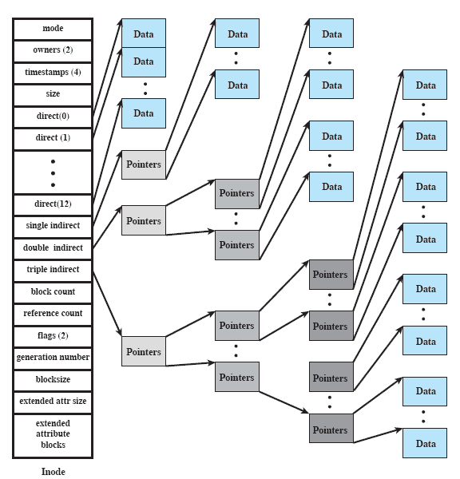
FreeBSD Inode and File Structure
Notes:
The attributes of the file as well as its permissions and other control information
are stored in the inode. The exact inode structure varies from one UNIX
implementation to another. The FreeBSD inode structure, shown in Figure 12.16 ,
includes the following data elements:
• The type and access mode of the file
• The file’s owner and group-access identifiers
• The time that the file was created, when it was most recently read and written, and when its inode was most recently updated by the system
• The size of the file in bytes
• A sequence of block pointers, explained in the next subsection
• The number of physical blocks used by the file, including blocks used to hold indirect pointers and attributes
• The number of directory entries that reference the file
• The kernel and user-settable flags that describe the characteristics of the file
• The generation number of the file (a randomly selected number assigned to the inode each time that the latter is allocated to a new file; the generation number is used to detect references to deleted files)
• The blocksize of the data blocks referenced by the inode (typically the same as, but sometimes larger than, the file system blocksize)
The size of the extended attribute information
• Zero or more extended attribute entries
The blocksize value is typically the same as, but sometimes larger than, the file
system blocksize. On traditional UNIX systems, a fixed blocksize of 512 bytes was
used. FreeBSD has a minimum blocksize of 4,096 bytes (4 Kbytes); the blocksize
can be any power of 2 greater than or equal to 4,096. For typical file systems, the
blocksize is 8 Kbytes or 16 Kbytes. The default FreeBSD blocksize is 16 Kbytes.
Extended attribute entries are variable-length entries used to store auxiliary
data that are separate from the contents of the file. The first two extended attributes
defined for FreeBSD deal with security. The first of these support access control
lists; this is described in Chapter 15 . The second defined extended attribute supports
the use of security labels, which are part of what is known as a mandatory
access control scheme, also defined in Chapter 15 .
On the disk, there is an inode table, or inode list, that contains the inodes of
all the files in the file system. When a file is opened, its inode is brought into main
memory and stored in a memory-resident inode table.

Slide 108
FreeBSD Inode and File Structure
The exact inode structure varies from one UNIX implementation to another.
FreeBSD is a free and open-source Unix operating system
Notes:
The attributes of the file as well as its permissions and other control information
are stored in the inode. The exact inode structure varies from one UNIX
implementation to another. The FreeBSD inode structure, shown in Figure 12.16 ,
includes the following data elements:
• The type and access mode of the file
• The file’s owner and group-access identifiers
• The time that the file was created, when it was most recently read and written, and when its inode was most recently updated by the system
• The size of the file in bytes
• A sequence of block pointers, explained in the next subsection
• The number of physical blocks used by the file, including blocks used to hold indirect pointers and attributes
• The number of directory entries that reference the file
• The kernel and user-settable flags that describe the characteristics of the file
• The generation number of the file (a randomly selected number assigned to the inode each time that the latter is allocated to a new file; the generation number is used to detect references to deleted files)
• The blocksize of the data blocks referenced by the inode (typically the same as, but sometimes larger than, the file system blocksize)
The size of the extended attribute information
• Zero or more extended attribute entries
The blocksize value is typically the same as, but sometimes larger than, the file
system blocksize. On traditional UNIX systems, a fixed blocksize of 512 bytes was
used. FreeBSD has a minimum blocksize of 4,096 bytes (4 Kbytes); the blocksize
can be any power of 2 greater than or equal to 4,096. For typical file systems, the
blocksize is 8 Kbytes or 16 Kbytes. The default FreeBSD blocksize is 16 Kbytes.
Extended attribute entries are variable-length entries used to store auxiliary
data that are separate from the contents of the file. The first two extended attributes
defined for FreeBSD deal with security. The first of these support access control
lists; this is described in Chapter 15 . The second defined extended attribute supports
the use of security labels, which are part of what is known as a mandatory
access control scheme, also defined in Chapter 15 .
On the disk, there is an inode table, or inode list, that contains the inodes of
all the files in the file system. When a file is opened, its inode is brought into main
memory and stored in a memory-resident inode table.

Slide 109
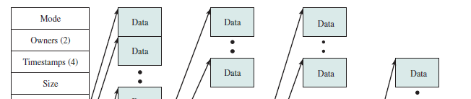
FreeBSD Inode and File Structure
The FreeBSD inode structure,
includes the following data elements:
• The type and access mode of the file
• The file’s owner and group-access identifiers
Notes:
The attributes of the file as well as its permissions and other control information
are stored in the inode. The exact inode structure varies from one UNIX
implementation to another. The FreeBSD inode structure, shown in Figure 12.16 ,
includes the following data elements:
• The type and access mode of the file
• The file’s owner and group-access identifiers
• The time that the file was created, when it was most recently read and written, and when its inode was most recently updated by the system
• The size of the file in bytes
• A sequence of block pointers, explained in the next subsection
• The number of physical blocks used by the file, including blocks used to hold indirect pointers and attributes
• The number of directory entries that reference the file
• The kernel and user-settable flags that describe the characteristics of the file
• The generation number of the file (a randomly selected number assigned to the inode each time that the latter is allocated to a new file; the generation number is used to detect references to deleted files)
• The blocksize of the data blocks referenced by the inode (typically the same as, but sometimes larger than, the file system blocksize)
The size of the extended attribute information
• Zero or more extended attribute entries
The blocksize value is typically the same as, but sometimes larger than, the file
system blocksize. On traditional UNIX systems, a fixed blocksize of 512 bytes was
used. FreeBSD has a minimum blocksize of 4,096 bytes (4 Kbytes); the blocksize
can be any power of 2 greater than or equal to 4,096. For typical file systems, the
blocksize is 8 Kbytes or 16 Kbytes. The default FreeBSD blocksize is 16 Kbytes.
Extended attribute entries are variable-length entries used to store auxiliary
data that are separate from the contents of the file. The first two extended attributes
defined for FreeBSD deal with security. The first of these support access control
lists; this is described in Chapter 15 . The second defined extended attribute supports
the use of security labels, which are part of what is known as a mandatory
access control scheme, also defined in Chapter 15 .
On the disk, there is an inode table, or inode list, that contains the inodes of
all the files in the file system. When a file is opened, its inode is brought into main
memory and stored in a memory-resident inode table.

Slide 110
FreeBSD Inode and File Structure
The time that the file was created, when it was most recently read and written,and when its inode was most recently updated by the system
The size of the file in bytes
Notes:
The attributes of the file as well as its permissions and other control information
are stored in the inode. The exact inode structure varies from one UNIX
implementation to another. The FreeBSD inode structure, shown in Figure 12.16 ,
includes the following data elements:
• The type and access mode of the file
• The file’s owner and group-access identifiers
• The time that the file was created, when it was most recently read and written, and when its inode was most recently updated by the system
• The size of the file in bytes
• A sequence of block pointers, explained in the next subsection
• The number of physical blocks used by the file, including blocks used to hold indirect pointers and attributes
• The number of directory entries that reference the file
• The kernel and user-settable flags that describe the characteristics of the file
• The generation number of the file (a randomly selected number assigned to the inode each time that the latter is allocated to a new file; the generation number is used to detect references to deleted files)
• The blocksize of the data blocks referenced by the inode (typically the same as, but sometimes larger than, the file system blocksize)
The size of the extended attribute information
• Zero or more extended attribute entries
The blocksize value is typically the same as, but sometimes larger than, the file
system blocksize. On traditional UNIX systems, a fixed blocksize of 512 bytes was
used. FreeBSD has a minimum blocksize of 4,096 bytes (4 Kbytes); the blocksize
can be any power of 2 greater than or equal to 4,096. For typical file systems, the
blocksize is 8 Kbytes or 16 Kbytes. The default FreeBSD blocksize is 16 Kbytes.
Extended attribute entries are variable-length entries used to store auxiliary
data that are separate from the contents of the file. The first two extended attributes
defined for FreeBSD deal with security. The first of these support access control
lists; this is described in Chapter 15 . The second defined extended attribute supports
the use of security labels, which are part of what is known as a mandatory
access control scheme, also defined in Chapter 15 .
On the disk, there is an inode table, or inode list, that contains the inodes of
all the files in the file system. When a file is opened, its inode is brought into main
memory and stored in a memory-resident inode table.

Slide 111
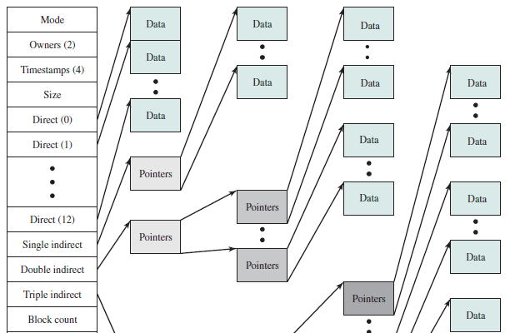
FreeBSD Inode and File Structure
• A sequence of block pointers
The number of physical blocks used by the file, including blocks used to hold
indirect pointers and attributes
Notes:
The attributes of the file as well as its permissions and other control information
are stored in the inode. The exact inode structure varies from one UNIX
implementation to another. The FreeBSD inode structure, shown in Figure 12.16 ,
includes the following data elements:
• The type and access mode of the file
• The file’s owner and group-access identifiers
• The time that the file was created, when it was most recently read and written, and when its inode was most recently updated by the system
• The size of the file in bytes
• A sequence of block pointers, explained in the next subsection
• The number of physical blocks used by the file, including blocks used to hold indirect pointers and attributes
• The number of directory entries that reference the file
• The kernel and user-settable flags that describe the characteristics of the file
• The generation number of the file (a randomly selected number assigned to the inode each time that the latter is allocated to a new file; the generation number is used to detect references to deleted files)
• The blocksize of the data blocks referenced by the inode (typically the same as, but sometimes larger than, the file system blocksize)
The size of the extended attribute information
• Zero or more extended attribute entries
The blocksize value is typically the same as, but sometimes larger than, the file
system blocksize. On traditional UNIX systems, a fixed blocksize of 512 bytes was
used. FreeBSD has a minimum blocksize of 4,096 bytes (4 Kbytes); the blocksize
can be any power of 2 greater than or equal to 4,096. For typical file systems, the
blocksize is 8 Kbytes or 16 Kbytes. The default FreeBSD blocksize is 16 Kbytes.
Extended attribute entries are variable-length entries used to store auxiliary
data that are separate from the contents of the file. The first two extended attributes
defined for FreeBSD deal with security. The first of these support access control
lists; this is described in Chapter 15 . The second defined extended attribute supports
the use of security labels, which are part of what is known as a mandatory
access control scheme, also defined in Chapter 15 .
On the disk, there is an inode table, or inode list, that contains the inodes of
all the files in the file system. When a file is opened, its inode is brought into main
memory and stored in a memory-resident inode table.

Slide 112
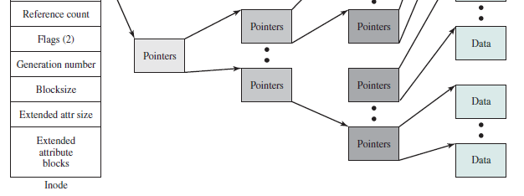
FreeBSD Inode and File Structure
• The number of directory entries that reference the file
• The kernel and user-settable flags that describe the characteristics of the file
Notes:
The attributes of the file as well as its permissions and other control information
are stored in the inode. The exact inode structure varies from one UNIX
implementation to another. The FreeBSD inode structure, shown in Figure 12.16 ,
includes the following data elements:
• The type and access mode of the file
• The file’s owner and group-access identifiers
• The time that the file was created, when it was most recently read and written, and when its inode was most recently updated by the system
• The size of the file in bytes
• A sequence of block pointers, explained in the next subsection
• The number of physical blocks used by the file, including blocks used to hold indirect pointers and attributes
• The number of directory entries that reference the file
• The kernel and user-settable flags that describe the characteristics of the file
• The generation number of the file (a randomly selected number assigned to the inode each time that the latter is allocated to a new file; the generation number is used to detect references to deleted files)
• The blocksize of the data blocks referenced by the inode (typically the same as, but sometimes larger than, the file system blocksize)
The size of the extended attribute information
• Zero or more extended attribute entries
The blocksize value is typically the same as, but sometimes larger than, the file
system blocksize. On traditional UNIX systems, a fixed blocksize of 512 bytes was
used. FreeBSD has a minimum blocksize of 4,096 bytes (4 Kbytes); the blocksize
can be any power of 2 greater than or equal to 4,096. For typical file systems, the
blocksize is 8 Kbytes or 16 Kbytes. The default FreeBSD blocksize is 16 Kbytes.
Extended attribute entries are variable-length entries used to store auxiliary
data that are separate from the contents of the file. The first two extended attributes
defined for FreeBSD deal with security. The first of these support access control
lists; this is described in Chapter 15 . The second defined extended attribute supports
the use of security labels, which are part of what is known as a mandatory
access control scheme, also defined in Chapter 15 .
On the disk, there is an inode table, or inode list, that contains the inodes of
all the files in the file system. When a file is opened, its inode is brought into main
memory and stored in a memory-resident inode table.

Slide 113
FreeBSD Inode and File Structure
• The generation number of the file (a randomly selected number assigned to the inode, each time that the latter is allocated to a new file;
• The blocksize of the data blocks referenced by the inode
Notes:
The attributes of the file as well as its permissions and other control information
are stored in the inode. The exact inode structure varies from one UNIX
implementation to another. The FreeBSD inode structure, shown in Figure 12.16 ,
includes the following data elements:
• The type and access mode of the file
• The file’s owner and group-access identifiers
• The time that the file was created, when it was most recently read and written, and when its inode was most recently updated by the system
• The size of the file in bytes
• A sequence of block pointers, explained in the next subsection
• The number of physical blocks used by the file, including blocks used to hold indirect pointers and attributes
• The number of directory entries that reference the file
• The kernel and user-settable flags that describe the characteristics of the file
• The generation number of the file (a randomly selected number assigned to the inode each time that the latter is allocated to a new file; the generation number is used to detect references to deleted files)
• The blocksize of the data blocks referenced by the inode (typically the same as, but sometimes larger than, the file system blocksize)
The size of the extended attribute information
• Zero or more extended attribute entries
The blocksize value is typically the same as, but sometimes larger than, the file
system blocksize. On traditional UNIX systems, a fixed blocksize of 512 bytes was
used. FreeBSD has a minimum blocksize of 4,096 bytes (4 Kbytes); the blocksize
can be any power of 2 greater than or equal to 4,096. For typical file systems, the
blocksize is 8 Kbytes or 16 Kbytes. The default FreeBSD blocksize is 16 Kbytes.
Extended attribute entries are variable-length entries used to store auxiliary
data that are separate from the contents of the file. The first two extended attributes
defined for FreeBSD deal with security. The first of these support access control
lists; this is described in Chapter 15 . The second defined extended attribute supports
the use of security labels, which are part of what is known as a mandatory
access control scheme, also defined in Chapter 15 .
On the disk, there is an inode table, or inode list, that contains the inodes of
all the files in the file system. When a file is opened, its inode is brought into main
memory and stored in a memory-resident inode table.

Slide 114
FreeBSD Inode and File Structure
On the disk, there is an inode table, or inode list,
that contains the inodes of all the files in the file system.
When a file is opened,
its inode is brought into main memory and stored in a memory-resident inode table.
Notes:
The attributes of the file as well as its permissions and other control information
are stored in the inode. The exact inode structure varies from one UNIX
implementation to another. The FreeBSD inode structure, shown in Figure 12.16 ,
includes the following data elements:
• The type and access mode of the file
• The file’s owner and group-access identifiers
• The time that the file was created, when it was most recently read and written, and when its inode was most recently updated by the system
• The size of the file in bytes
• A sequence of block pointers, explained in the next subsection
• The number of physical blocks used by the file, including blocks used to hold indirect pointers and attributes
• The number of directory entries that reference the file
• The kernel and user-settable flags that describe the characteristics of the file
• The generation number of the file (a randomly selected number assigned to the inode each time that the latter is allocated to a new file; the generation number is used to detect references to deleted files)
• The blocksize of the data blocks referenced by the inode (typically the same as, but sometimes larger than, the file system blocksize)
The size of the extended attribute information
• Zero or more extended attribute entries
The blocksize value is typically the same as, but sometimes larger than, the file
system blocksize. On traditional UNIX systems, a fixed blocksize of 512 bytes was
used. FreeBSD has a minimum blocksize of 4,096 bytes (4 Kbytes); the blocksize
can be any power of 2 greater than or equal to 4,096. For typical file systems, the
blocksize is 8 Kbytes or 16 Kbytes. The default FreeBSD blocksize is 16 Kbytes.
Extended attribute entries are variable-length entries used to store auxiliary
data that are separate from the contents of the file. The first two extended attributes
defined for FreeBSD deal with security. The first of these support access control
lists; this is described in Chapter 15 . The second defined extended attribute supports
the use of security labels, which are part of what is known as a mandatory
access control scheme, also defined in Chapter 15 .
On the disk, there is an inode table, or inode list, that contains the inodes of
all the files in the file system. When a file is opened, its inode is brought into main
memory and stored in a memory-resident inode table.

Slide 115
File Allocation-Unix
File allocation is done on a block basis
Allocation is dynamic, as needed, rather than using preallocation
An indexed method is used to keep track of each file, with part of the index stored in the inode for the file
In all UNIX implementations, the inode includes a number of direct pointers and three indirect pointers (single, double, triple)
Notes:
File allocation is done on a block basis. Allocation is dynamic, as needed, rather
than using preallocation. Hence, the blocks of a file on disk are not necessarily contiguous.
An indexed method is used to keep track of each file, with part of the index
stored in the inode for the file. In all UNIX implementations, the inode includes a
number of direct pointers and three indirect pointers (single, double, triple).
The FreeBSD inode includes 120 bytes of address information that is organized
as fifteen 64-bit addresses, or pointers. The first 12 addresses point to the first
12 data blocks of the file. If the file requires more than 12 data blocks, one or more
levels of indirection is used as follows:
• The thirteenth address in the inode points to a block on disk that contains the
next portion of the index. This is referred to as the single indirect block. This
block contains the pointers to succeeding blocks in the file.
• If the file contains more blocks, the fourteenth address in the inode points to
a double indirect block. This block contains a list of addresses of additional
single indirect blocks. Each of single indirect blocks, in turn, contains pointers
to file blocks.
• If the file contains still more blocks, the fifteenth address in the inode points
to a triple indirect block that is a third level of indexing. This block points to
additional double indirect blocks.
All of this is illustrated in Figure 12.16 .

Slide 116
UNIX Directories and Inodes
Directories are structured in a hierarchical tree
Each directory can contain files and/or other directories
A directory that is inside another directory is referred to as a subdirectory
Notes:
Directories are structured in a hierarchical tree. Each directory can contain files
and/or other directories. A directory that is inside another directory is referred to
as a subdirectory. As was mentioned, a directory is simply a file that contains a
list of file names plus pointers to associated inodes. Figure 12.17 shows the overall
structure. Each directory entry (dentry) contains a name for the associated file or
subdirectory plus an integer called the i-number (index number). When the file or
directory is accessed, its i-number is used as an index into the inode table.

Slide 117
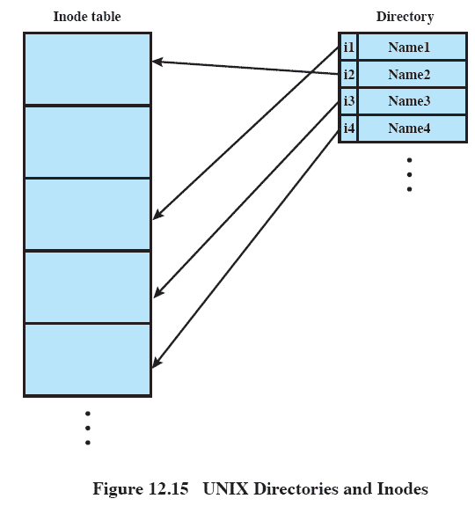
UNIX Directories and Inodes
A directory is simply a file that contains
a list of file names plus pointers to associated inodes.
Figure 12.17
Notes:
Directories are structured in a hierarchical tree. Each directory can contain files
and/or other directories. A directory that is inside another directory is referred to
as a subdirectory. As was mentioned, a directory is simply a file that contains a
list of file names plus pointers to associated inodes. Figure 12.17 shows the overall
structure. Each directory entry (dentry) contains a name for the associated file or
subdirectory plus an integer called the i-number (index number). When the file or
directory is accessed, its i-number is used as an index into the inode table.

Slide 118
UNIX Directories and Inodes
Each directory entry (dentry) contains a name for the associated file or subdirectory plus an integer called the i-number (index number).
When the file or directory is accessed, its i-number is used as an index into the inode table.
Figure 12.17
Notes:
Directories are structured in a hierarchical tree. Each directory can contain files
and/or other directories. A directory that is inside another directory is referred to
as a subdirectory. As was mentioned, a directory is simply a file that contains a
list of file names plus pointers to associated inodes. Figure 12.17 shows the overall
structure. Each directory entry (dentry) contains a name for the associated file or
subdirectory plus an integer called the i-number (index number). When the file or
directory is accessed, its i-number is used as an index into the inode table.

Slide 119
Volume Structure
Boot block
contains code required to boot the operating system
Superblock
contains attributes and information about the file system
Inode table
collection of inodes for each file
Data blocks
storage space available for data files and subdirectories
A UNIX file system resides on a single logical disk or disk partition and is laid out with the following elements:
Notes:
A UNIX file system resides on a single logical disk or disk partition and is laid out
with the following elements:
• Boot block: Contains code required to boot the operating system
• Superblock: Contains attributes and information about the file system, such as
partition size, and inode table size
• Inode table: The collection of inodes for each file
• Data blocks: Storage space available for data files and subdirectories

Slide 120
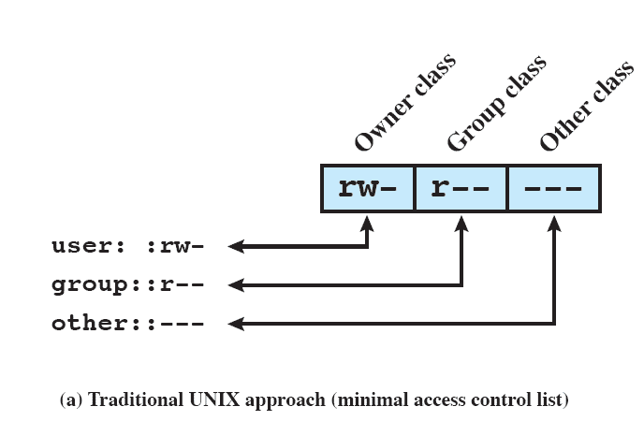


UNIX File Access Control
Notes:
Most UNIX systems depend on, or at least are based on, the file access control
scheme introduced with the early versions of UNIX. Each UNIX user is assigned a
unique user identification number (user ID). A user is also a member of a primary
group, and possibly a number of other groups, each identified by a group ID. When
a file is created, it is designated as owned by a particular user and marked with that
user’s ID. It also belongs to a specific group, which initially is either its creator’s
primary group, or the group of its parent directory if that directory has SetGID
permission set. Associated with each file is a set of 12 protection bits. The owner ID,
group ID, and protection bits are part of the file’s inode.
Nine of the protection bits specify read, write, and execute permission for the
owner of the file, other members of the group to which this file belongs, and all
other users. These form a hierarchy of owner, group, and all others, with the highest
relevant set of permissions being used. Figure 12.18a shows an example in which the
file owner has read and write access; all other members of the file’s group have read
access, and users outside the group have no access rights to the file. When applied to
a directory, the read and write bits grant the right to list and to create/rename/delete
files in the directory. The execute bit grants the right to search the directory for a
component of a filename.
The remaining three bits define special additional behavior for files or directories.
Two of these are the “set user ID” (SetUID) and “set group ID” (SetGID)
permissions. If these are set on an executable file, the operating system functions as
follows. When a user (with execute privileges for this file) executes the file, the system
temporarily allocates the rights of the user’s ID of the file creator, or the file’s
group, respectively, to those of the user executing the file. These are known as the
“effective user ID” and “effective group ID” and are used in addition to the “real
user ID” and “real group ID” of the executing user when making access control
decisions for this program. This change is only effective while the program is being
executed. This feature enables the creation and use of privileged programs that may
use files normally inaccessible to other users. It enables users to access certain files
in a controlled fashion. Alternatively, when applied to a directory, the SetGID permission
indicates that newly created files will inherit the group of this directory. The
SetUID permission is ignored.
The final permission bit is the “Sticky” bit. When set on a file, this originally
indicated that the system should retain the file contents in memory following execution.
This is no longer used. When applied to a directory, though, it specifies that
only the owner of any file in the directory can rename, move, or delete that file. This
is useful for managing files in shared temporary directories.
One particular user ID is designated as “superuser.” The superuser is exempt
from the usual file access control constraints and has systemwide access. Any
program that is owned by, and SetUID to, the “superuser” potentially grants unrestricted
access to the system to any user executing that program. Hence, great care
is needed when writing such programs.
This access scheme is adequate when file access requirements align with users
and a modest number of groups of users. For example, suppose a user wants to give
read access for file X to users A and B and read access for file Y to users B and C.
We would need at least two user groups, and user B would need to belong to both
groups in order to access the two files. However, if there are a large number of
different groupings of users requiring a range of access rights to different files, then
a very large number of groups may be needed to provide this. This rapidly becomes
unwieldy and difficult to manage, even if possible at all. 6 One way to overcome this
problem is to use access control lists, which are provided in most modern UNIX
systems.
A final point to note is that the traditional UNIX file access control scheme
implements a simple protection domain structure. A domain is associated with the
user, and switching the domain corresponds to changing the user ID temporarily.

Slide 121
Access Control Lists in UNIX
FreeBSD allows the administrator to assign a list of UNIX user IDs and groups to a file
Any number of users and groups can be associated with a file, each with three protection bits (read, write, execute)
A file may be protected solely by the traditional UNIX file access mechanism
FreeBSD files include an additional protection bit that indicates whether the file has an extended ACL
Notes:
Many modern UNIX and UNIX-based operating systems support access control
lists, including FreeBSD, OpenBSD, Linux, and Solaris. In this section, we describe
the FreeBSD approach, but other implementations have essentially the same features
and interface. The feature is referred to as extended access control list, while
the traditional UNIX approach is referred to as minimal access control list.
FreeBSD allows the administrator to assign a list of UNIX user IDs and
groups to a file by using the setfacl command. Any number of users and groups
can be associated with a file, each with three protection bits (read, write, execute),
offering a flexible mechanism for assigning access rights. A file need not have an
ACL but may be protected solely by the traditional UNIX file access mechanism.
FreeBSD files include an additional protection bit that indicates whether the file
has an extended ACL.
FreeBSD and most UNIX implementations that support extended ACLs use
the following strategy (e.g., Figure 12.18b ):
1. The owner class and other class entries in the nine-bit permission field have
the same meaning as in the minimal ACL case.
2. The group class entry specifies the permissions for the owner group for this
file. These permissions represent the maximum permissions that can be
assigned to named users or named groups, other than the owning user. In this
latter role, the group class entry functions as a mask.
3. Additional named users and named groups may be associated with the file,
each with a three-bit permission field. The permissions listed for a named
user or named group are compared to the mask field. Any permission
for the named user or named group that is not present in the mask field is
disallowed.
When a process requests access to a file system object, two steps are performed.
Step 1 selects the ACL entry that most closely matches the requesting process. The
ACL entries are looked at in the following order: owner, named users, (owning or
named) groups, and others. Only a single entry determines access. Step 2 checks
if the matching entry contains sufficient permissions. A process can be a member
in more than one group; so more than one group entry can match. If any of these
matching group entries contain the requested permissions, one that contains the
requested permissions is picked (the result is the same no matter which entry is
picked). If none of the matching group entries contains the requested permissions,
access will be denied no matter which entry is picked.

Slide 122
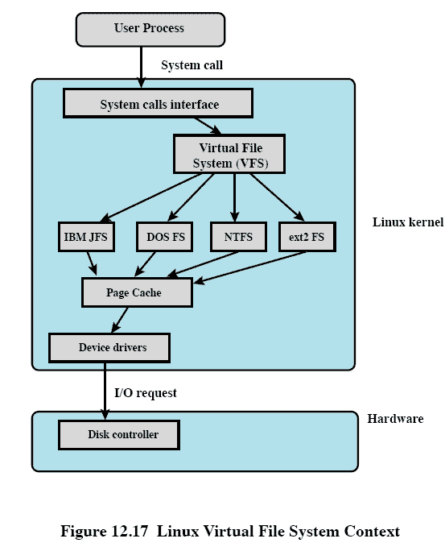
Linux Virtual File System (VFS)
Linux includes a versatile and powerful file-handling facility,
Designed to support a wide variety of file management systems and file structures.
Presents a single, uniform file system interface to user processes
Notes:
Linux includes a versatile and powerful file-handling facility, designed to support a
wide variety of file management systems and file structures. The approach taken in
Linux is to make use of a virtual file system (VFS) , which presents a single, uniform
file system interface to user processes. The VFS defines a common file model that is
capable of representing any conceivable file system’s general feature and behavior.
The VFS assumes that files are objects in a computer’s mass storage memory that
share basic properties regardless of the target file system or the underlying processor
hardware. Files have symbolic names that allow them to be uniquely identified
within a specific directory within the file system. A file has an owner, protection
against unauthorized access or modification, and a variety of other properties. A
file may be created, read from, written to, or deleted. For any specific file system, a
mapping module is needed to transform the characteristics of the real file system to
the characteristics expected by the virtual file system.
Figure 12.19 indicates the key ingredients of the Linux file system strategy. A
user process issues a file system call (e.g., read) using the VFS file scheme. The VFS
converts this into an internal (to the kernel) file system call that is passed to a mapping
function for a specific file system [e.g., IBM’s Journaling File System (JFS)]. In
most cases, the mapping function is simply a mapping of file system functional calls
from one scheme to another. In some cases, the mapping function is more complex.
For example, some file systems use a file allocation table (FAT), which stores the
position of each file in the directory tree. In these file systems, directories are not
files. For such file systems, the mapping function must be able to construct dynamically,
and when needed, the files corresponding to the directories. In any case, the
original user file system call is translated into a call that is native to the target file
system. The target file system software is then invoked to perform the requested
function on a file or directory under its control and secondary storage. The results
of the operation are then communicated back to the user in a similar fashion.

Slide 123
Linux Virtual File System (VFS)
Linux includes a versatile and powerful file-handling facility,
Designed to support a wide variety of file management systems and file structures.
Presents a single, uniform file system interface to user processes
Notes:
Linux includes a versatile and powerful file-handling facility, designed to support a
wide variety of file management systems and file structures. The approach taken in
Linux is to make use of a virtual file system (VFS) , which presents a single, uniform
file system interface to user processes. The VFS defines a common file model that is
capable of representing any conceivable file system’s general feature and behavior.
The VFS assumes that files are objects in a computer’s mass storage memory that
share basic properties regardless of the target file system or the underlying processor
hardware. Files have symbolic names that allow them to be uniquely identified
within a specific directory within the file system. A file has an owner, protection
against unauthorized access or modification, and a variety of other properties. A
file may be created, read from, written to, or deleted. For any specific file system, a
mapping module is needed to transform the characteristics of the real file system to
the characteristics expected by the virtual file system.
Figure 12.19 indicates the key ingredients of the Linux file system strategy. A
user process issues a file system call (e.g., read) using the VFS file scheme. The VFS
converts this into an internal (to the kernel) file system call that is passed to a mapping
function for a specific file system [e.g., IBM’s Journaling File System (JFS)]. In
most cases, the mapping function is simply a mapping of file system functional calls
from one scheme to another. In some cases, the mapping function is more complex.
For example, some file systems use a file allocation table (FAT), which stores the
position of each file in the directory tree. In these file systems, directories are not
files. For such file systems, the mapping function must be able to construct dynamically,
and when needed, the files corresponding to the directories. In any case, the
original user file system call is translated into a call that is native to the target file
system. The target file system software is then invoked to perform the requested
function on a file or directory under its control and secondary storage. The results
of the operation are then communicated back to the user in a similar fashion.

Slide 124
Linux Virtual File System (VFS)
Defines a common file model that is
capable of representing any conceivable file system’s general feature and behavior
Notes:
Linux includes a versatile and powerful file-handling facility, designed to support a
wide variety of file management systems and file structures. The approach taken in
Linux is to make use of a virtual file system (VFS) , which presents a single, uniform
file system interface to user processes. The VFS defines a common file model that is
capable of representing any conceivable file system’s general feature and behavior.
The VFS assumes that files are objects in a computer’s mass storage memory that
share basic properties regardless of the target file system or the underlying processor
hardware. Files have symbolic names that allow them to be uniquely identified
within a specific directory within the file system. A file has an owner, protection
against unauthorized access or modification, and a variety of other properties. A
file may be created, read from, written to, or deleted. For any specific file system, a
mapping module is needed to transform the characteristics of the real file system to
the characteristics expected by the virtual file system.
Figure 12.19 indicates the key ingredients of the Linux file system strategy. A
user process issues a file system call (e.g., read) using the VFS file scheme. The VFS
converts this into an internal (to the kernel) file system call that is passed to a mapping
function for a specific file system [e.g., IBM’s Journaling File System (JFS)]. In
most cases, the mapping function is simply a mapping of file system functional calls
from one scheme to another. In some cases, the mapping function is more complex.
For example, some file systems use a file allocation table (FAT), which stores the
position of each file in the directory tree. In these file systems, directories are not
files. For such file systems, the mapping function must be able to construct dynamically,
and when needed, the files corresponding to the directories. In any case, the
original user file system call is translated into a call that is native to the target file
system. The target file system software is then invoked to perform the requested
function on a file or directory under its control and secondary storage. The results
of the operation are then communicated back to the user in a similar fashion.

Slide 125
Linux Virtual File System (VFS)
VFS Assumes files are objects that share basic properties regardless of the target file system or the underlying processor hardware
Notes:
Linux includes a versatile and powerful file-handling facility, designed to support a
wide variety of file management systems and file structures. The approach taken in
Linux is to make use of a virtual file system (VFS) , which presents a single, uniform
file system interface to user processes. The VFS defines a common file model that is
capable of representing any conceivable file system’s general feature and behavior.
The VFS assumes that files are objects in a computer’s mass storage memory that
share basic properties regardless of the target file system or the underlying processor
hardware. Files have symbolic names that allow them to be uniquely identified
within a specific directory within the file system. A file has an owner, protection
against unauthorized access or modification, and a variety of other properties. A
file may be created, read from, written to, or deleted. For any specific file system, a
mapping module is needed to transform the characteristics of the real file system to
the characteristics expected by the virtual file system.
Figure 12.19 indicates the key ingredients of the Linux file system strategy. A
user process issues a file system call (e.g., read) using the VFS file scheme. The VFS
converts this into an internal (to the kernel) file system call that is passed to a mapping
function for a specific file system [e.g., IBM’s Journaling File System (JFS)]. In
most cases, the mapping function is simply a mapping of file system functional calls
from one scheme to another. In some cases, the mapping function is more complex.
For example, some file systems use a file allocation table (FAT), which stores the
position of each file in the directory tree. In these file systems, directories are not
files. For such file systems, the mapping function must be able to construct dynamically,
and when needed, the files corresponding to the directories. In any case, the
original user file system call is translated into a call that is native to the target file
system. The target file system software is then invoked to perform the requested
function on a file or directory under its control and secondary storage. The results
of the operation are then communicated back to the user in a similar fashion.

Slide 126
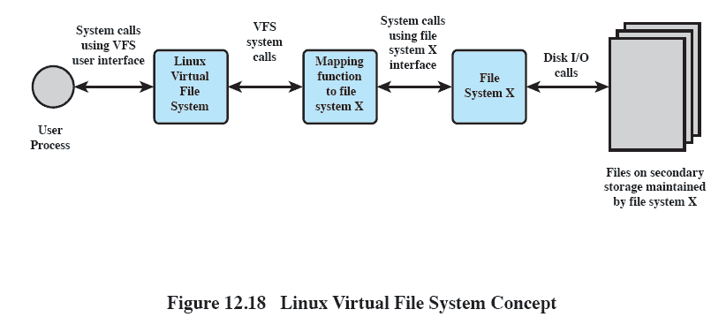
The Role of VFS Within the Kernel
Notes:
Figure 12.20 indicates the role that VFS plays within the Linux kernel. When
a process initiates a file-oriented system call (e.g., read), the kernel calls a function
in the VFS. This function handles the file-system-independent manipulations and
initiates a call to a function in the target file system code. This call passes through
a mapping function that converts the call from the VFS into a call to the target file
system. The VFS is independent of any file system, so the implementation of a mapping
function must be part of the implementation of a file system on Linux. The
target file system converts the file system request into device-oriented instructions
that are passed to a device driver by means of page cache functions.
VFS is an object-oriented scheme. Because it is written in C, rather than a
language that supports object programming (such as C++ or Java), VFS objects are
implemented simply as C data structures. Each object contains both data and pointers
to file-system-implemented functions that operate on data.

Slide 127
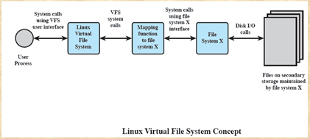
The Role of VFS Within the Kernel
A user process issues a file system call (e.g., read) using the VFS file scheme.
The VFS converts this into an internal (to the kernel) file system call that is passed to a mapping function for a specific file system [e.g., IBM’s Journaling File System (JFS)].
The mapping function is simply a mapping of file system functional calls from one scheme to another.
Notes:
Figure 12.20 indicates the role that VFS plays within the Linux kernel. When
a process initiates a file-oriented system call (e.g., read), the kernel calls a function
in the VFS. This function handles the file-system-independent manipulations and
initiates a call to a function in the target file system code. This call passes through
a mapping function that converts the call from the VFS into a call to the target file
system. The VFS is independent of any file system, so the implementation of a mapping
function must be part of the implementation of a file system on Linux. The
target file system converts the file system request into device-oriented instructions
that are passed to a device driver by means of page cache functions.
VFS is an object-oriented scheme. Because it is written in C, rather than a
language that supports object programming (such as C++ or Java), VFS objects are
implemented simply as C data structures. Each object contains both data and pointers
to file-system-implemented functions that operate on data.

Slide 128
Primary Object Types in VFS
VFS is an object-oriented scheme.
Because it is written in C, rather than a language that supports object programming (such as C++ or Java),
VFS objects are implemented simply as C data structures.
Notes:
Many modern UNIX and UNIX-based operating systems support access control
lists, including FreeBSD, OpenBSD, Linux, and Solaris. In this section, we describe
the FreeBSD approach, but other implementations have essentially the same features
and interface. The feature is referred to as extended access control list, while
the traditional UNIX approach is referred to as minimal access control list.
FreeBSD allows the administrator to assign a list of UNIX user IDs and
groups to a file by using the setfacl command. Any number of users and groups
can be associated with a file, each with three protection bits (read, write, execute),
offering a flexible mechanism for assigning access rights. A file need not have an
ACL but may be protected solely by the traditional UNIX file access mechanism.
FreeBSD files include an additional protection bit that indicates whether the file
has an extended ACL.
FreeBSD and most UNIX implementations that support extended ACLs use
the following strategy (e.g., Figure 12.18b ):
1. The owner class and other class entries in the nine-bit permission field have
the same meaning as in the minimal ACL case.
2. The group class entry specifies the permissions for the owner group for this
file. These permissions represent the maximum permissions that can be
assigned to named users or named groups, other than the owning user. In this
latter role, the group class entry functions as a mask.
3. Additional named users and named groups may be associated with the file,
each with a three-bit permission field. The permissions listed for a named
user or named group are compared to the mask field. Any permission
for the named user or named group that is not present in the mask field is
disallowed.
When a process requests access to a file system object, two steps are performed.
Step 1 selects the ACL entry that most closely matches the requesting process. The
ACL entries are looked at in the following order: owner, named users, (owning or
named) groups, and others. Only a single entry determines access. Step 2 checks
if the matching entry contains sufficient permissions. A process can be a member
in more than one group; so more than one group entry can match. If any of these
matching group entries contain the requested permissions, one that contains the
requested permissions is picked (the result is the same no matter which entry is
picked). If none of the matching group entries contains the requested permissions,
access will be denied no matter which entry is picked.

Slide 129

Primary Object Types in VFS
Superblock Object
represents a specific mounted file system
Dentry Object
represents a specific directory entry
Inode Object
represents a specific file
File Object
represents an open file associated with a process
Notes:
The four primary
object types in VFS are as follows:
• Superblock object: Represents a specific mounted file system
• Inode object: Represents a specific file
• Dentry object: Represents a specific directory entry
• File object: Represents an open file associated with a process
This scheme is based on the concepts used in UNIX file systems, as described in
Section 12.7 . The key concepts of UNIX file system to remember are the following. A
file system consists of a hierarchal organization of directories. A directory is the same
as what is known as a folder on many non-UNIX platforms and may contain files and/
or other directories. Because a directory may contain other directories, a tree structure
is formed. A path through the tree structure from the root consists of a sequence
of directory entries, ending in either a directory entry (dentry) or a file name. In
UNIX, a directory is implemented as a file that lists the files and directories contained
within it. Thus, file operations can be performed on either files or directories.

